Slide 1

强化学习
Reinforcement Learning

Slide 2
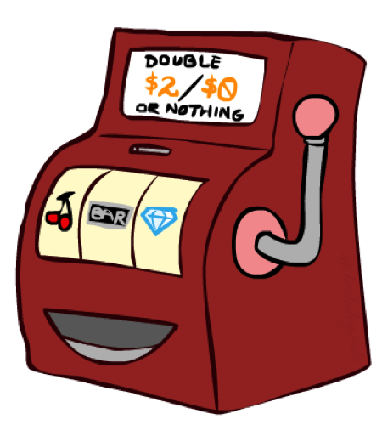
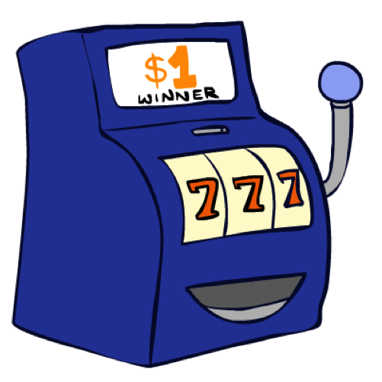

两个老虎机
Notes:
Double Bandits

Slide 3
两个老虎机 MDP
行动: Blue, Red
状态: Win, Lose
假设：奖赏没有折扣
玩 100 次
两个状态有相同的功效值
0.25 $0
0.75
$2
W
L
0.25
$0
$1
1.0
$1
1.0
0.75 $2

Slide 4
线下规划
求解 MDPs 是线下规划的过程
  通过计算确定所有的数量值
  需要知道MDP问题的细节
  实际上你并没有玩这个游戏!
假设：奖赏没有折扣
玩 100 次
两个状态有相同的功效值
0.25 $0
Value
0.75
$2
Play Red
W
0.25
$0
150
L
$1
1.0
$1
1.0
Play Blue
0.75 $2
100
Notes:
行动：总是选择红色的机器去玩。

Slide 5
实际地玩一下!
$2
$2
$0
$2
$2
$2
$2
$0
$0
$0
Notes:
10 times playing red machine expects for $15, actually got $12, simply close. This is a real playing, vs. offline planning for solving the MDP.

Slide 6
在线规划
规则改变了! 红色机器的中奖概率和以前不一样了(未知的)
?? $0
??
$2
W
L
??
$0
$1
1.0
$1
1.0
?? $2
Notes:
What should we do (optimal play) in this situation? Go to play in real world, because we don’t have enough information now.

Slide 7
Let’s Play!
$0
$0
$0
$2
$0
$2
$0
$0
$0
$0

Slide 8
强化学习
Agent
State: s
Reward: r
Actions: a
Environment
基本思想:
  通过 奖赏值 的形式来获得反馈
  智能体的功效值是由 奖赏函数(reward function)来定义的
  必须(通过学习) 行动，以获得最大化的期望奖赏值
  这里的学习是基于观察到的样本结果!

Slide 9
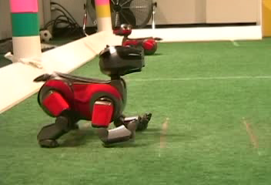

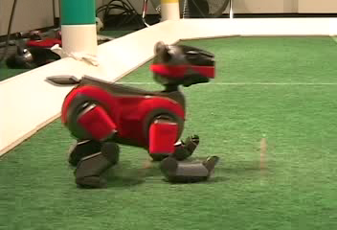
Example: Learning to Walk
Initial
A Learning Trial
After Learning [1K Trials]
[Kohl and Stone, ICRA 2004]

Slide 10

Example: Learning to Walk
Initial
[Kohl and Stone, ICRA 2004]
[Video: AIBO WALK – initial]
Notes:
Not very efficient.

Slide 11
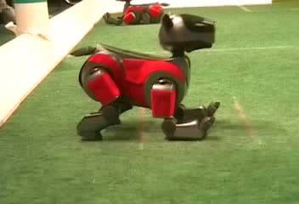
Example: Learning to Walk
Training
[Kohl and Stone, ICRA 2004]
[Video: AIBO WALK – training]

Slide 12

Example: Learning to Walk
Finished
[Kohl and Stone, ICRA 2004]
[Video: AIBO WALK – finished]

Slide 13

Example: Toddler Robot
[Tedrake, Zhang and Seung, 2005]
[Video: TODDLER – 40s]
Notes:
Get the robot to walk.

Slide 14
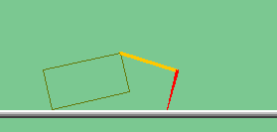
The Crawler!
[Demo: Crawler Bot (L10D1)] [You, in Project 3]
Notes:
At times no reward accumulated at all, just sitting still
Crawler (爬行者)

Slide 15

Video of Demo Crawler Bot
Notes:
Moving right to get 1 point, moving left to get -1 point. The goal is to maximize the total reward over time.

Slide 16
小结
刚才做的不是事先规划, 而是在实践中学习!
  这实际上就是 强化学习 (reinforcement learning)
  有这样一个 MDP问题, 但是你不知道它的细节所以不能预先计算求解
  需要实际去操作从而搞明白它是如何工作的
强化学习的重要思想：
  探索: 尝试不同的行动，从而获得相关的信息
  利用: 最终, 你需要利用所获得的知识
  遗憾误差(Regret): 即使很聪明地学习，也会犯错误
  采样: 由于存在概率因素, 需要重复的尝试
  难点: 这种学习比求解一个已知的MDP还要难

Slide 17
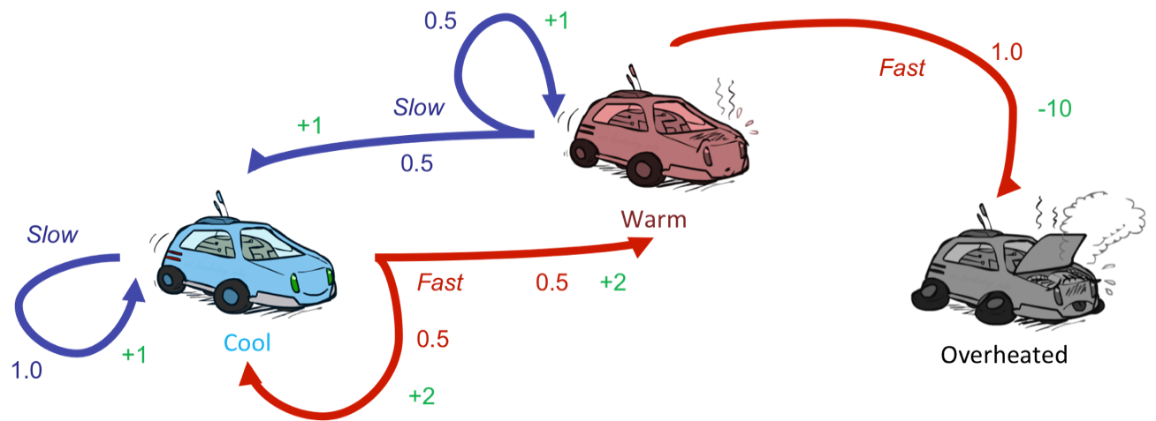
强化学习
依然假设是一个马可夫决策过程(MDP):
  一个 状态集合 s ∈ S
  一个 行动集合 A
  一个 转移模型 T(s,a,s’)
  一个 奖赏函数 R(s,a,s’)
仍旧是搜寻一个策略 π(s)
新的地方: 不知道 T 或 R
  不知道哪些状态是好的，或那些行动会带来什么
  必须在实践中尝试行动和状态，并从中进行学习

Slide 18
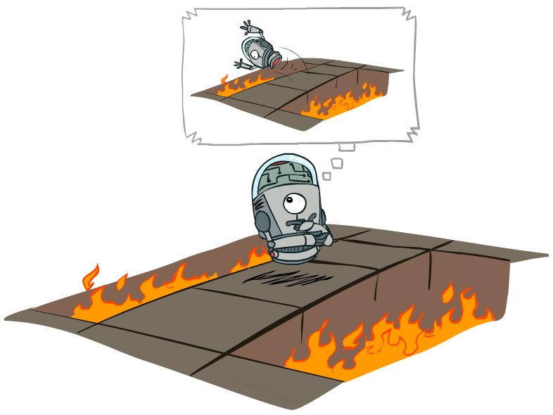
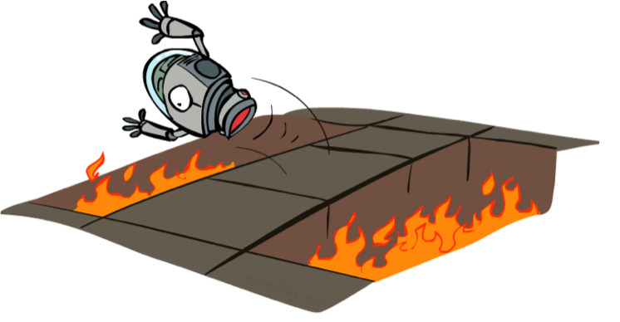
Offline (MDPs) vs. Online (RL)
Offline Solution
Online Learning
Notes:
In RL, we could have to try bad things, because that we don’t reward function and transition models.

Slide 19

基于模型的学习
Model-Based Learning
Notes:
Try to model (approximate) the T and R functions.

Slide 20




基于模型的学习
Model-Based Learning
思想:
  基于经验学习一个近似的模型
  利用学好的模型去求解当前的MDP问题(可以应用状态值迭代方法等)
步骤 1: 学习经验化的 MDP 模型
  对于每对 s,a，数出结果是 s’的数量
  归一化后给出一个估计
  当我们经历 (s, a, s’) 后，发现奖赏值
步骤 2: 求解基于学到的模型的 MDP
  例如, 使用状态值迭代法，就像之前一样进行线下求解

Slide 21
举例: 基于模型的学习
观察到的(训练过程)
学到的模型
输入策略 π
Episode 1
Episode 2
T(s,a,s’).
T(B, east, C) = 1.00
T(C, east, D) = 0.75
T(C, east, A) = 0.25
…
R(s,a,s’).
R(B, east, C) = -1
R(C, east, D) = -1
R(D, exit, x) = +10
…
 | A
B | C | D
 | E
B, east, C, -1
C, east, D, -1
D, exit, x, +10
B, east, C, -1
C, east, D, -1
D, exit, x, +10
Episode 3
Episode 4
E, north, C, -1
C, east, D, -1
D, exit, x, +10
E, north, C, -1
C, east, A, -1
A, exit, x, -10
Assume: γ = 1
Notes:
You act, and count, and build your model, and then use that model to solve the MDP. That’s basically what reinforcement learning does.

Slide 22
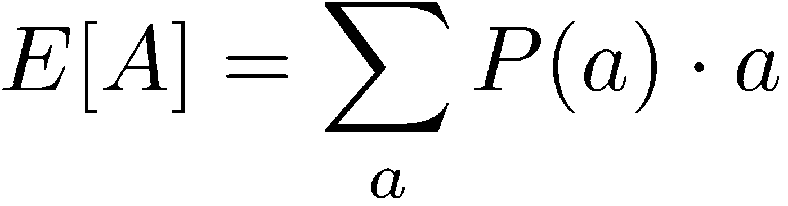
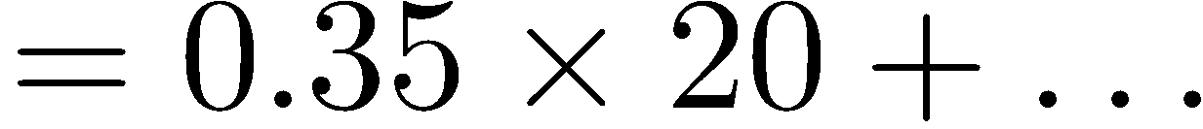
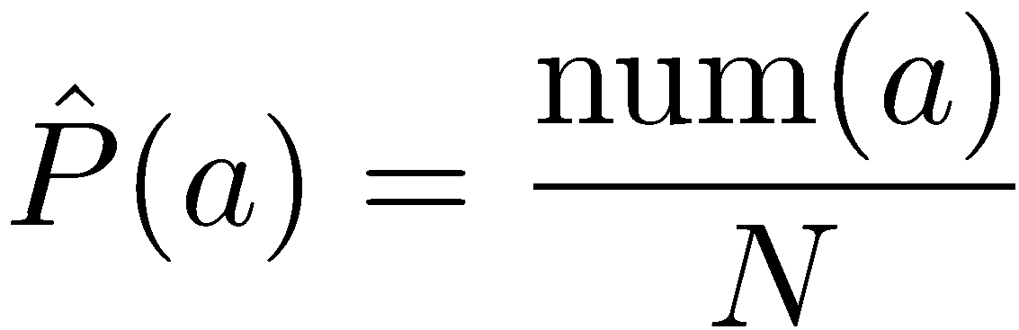
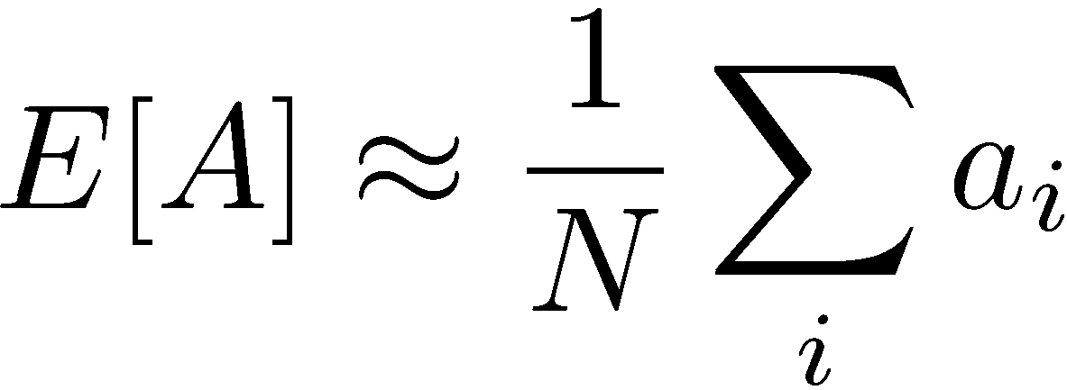
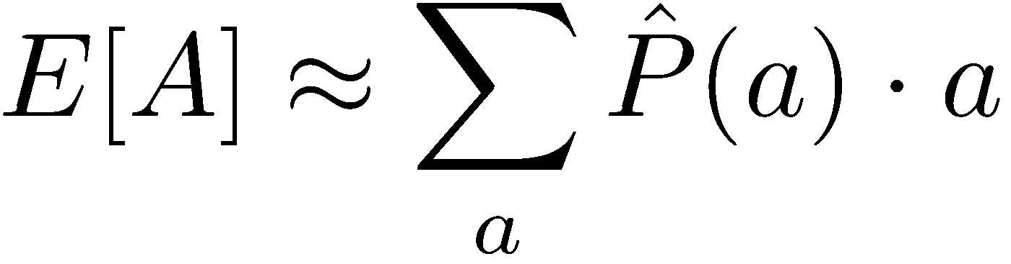
举例: 年龄期望值
目标: 计算班上同学的年龄期值
Known P(A)
如果事先没有 P(A), 那么可以进行采样 [a₁, a₂, … a_{N}]
Unknown P(A): “Model Based”
Unknown P(A): “Model Free”
Notes:
Example to illustrate what is the model-based and what is the model-free.
“Model-based ”:Why does this work? Because eventually you learn the right model.
“Model free”: Why does this work? Because samples appear with the right frequencies.

Slide 23
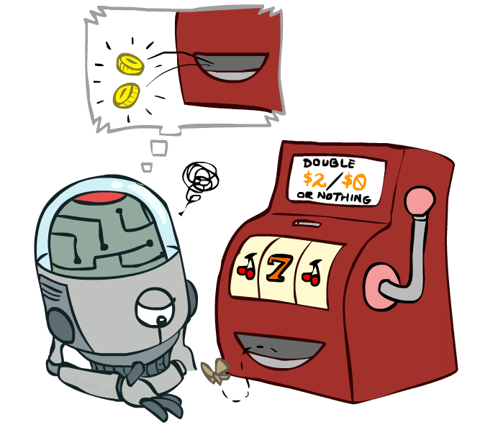
不基于模型的学习
Model-Free Learning

Slide 24
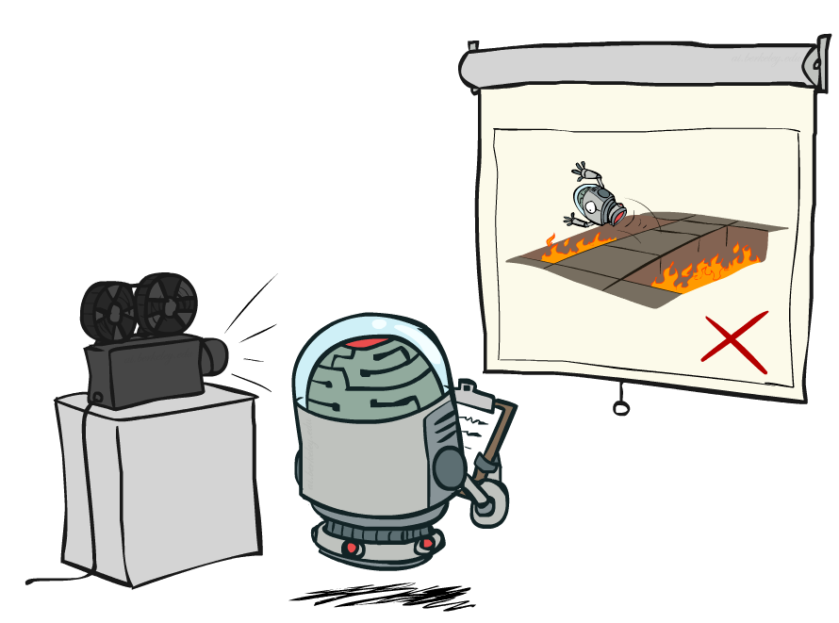
被动强化学习
Passive Reinforcement Learning
Notes:
Given a policy, acting, and observe state transition, and rewards. Try to estimate state values.
Evaluating the given policy.

Slide 25
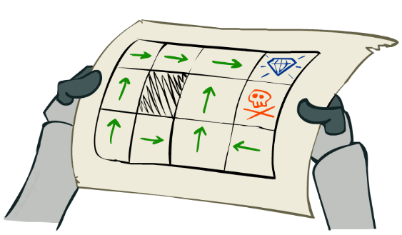
被动(passive)强化学习
简单的任务: 策略评价 policy evaluation
  输入: 一个跟定的策略 π(s)
  你不知道转移概率 T(s,a,s’)
  你不知道奖赏函数 R(s,a,s’)
  目标: 计算出状态值 (state values)
在这种情况下:
  Learner is “along for the ride”
  智能体自身没有行动的选择权
  只执行策略，并从经验中学习
  这并不是线下规划! You actually take actions in the world.

Slide 26
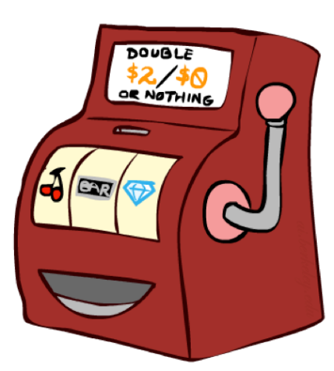
直接估值
目标: 在策略π下，计算每个状态的值
思想: 从每个样本进行估值，然后再平均化所有样本的值
  按照策略 π 进行行动
  每次你访问到一个状态, 记录下沿路折扣后的奖赏值之和
  再平均化那些样本估值
这就叫做直接估值

Slide 27
举例: 直接估值
观察到的样本 (训练)
输入策略 π
输出的状态值
Episode 1
Episode 2
B, east, C, -1
C, east, D, -1
D, exit, x, +10
B, east, C, -1
C, east, D, -1
D, exit, x, +10
 | A
B | C | D
 | E
 | A
B | C | D
 | E
-10
+8
+4
+10
Episode 3
Episode 4
-2
E, north, C, -1
C, east, D, -1
D, exit, x, +10
E, north, C, -1
C, east, A, -1
A, exit, x, -10
Assume: γ = 1
Notes:
State values – expected total reward when exiting the game. Simply take averages of those sums of sample sequences.
C: [3*9 + 1*(-11)] / 4 = 4
E: [8 + (-12)]/2 = -2

Slide 28
直接估值的问题所在
其优势?
  容易理解
  不需要知道 T, R
  最终计算正确的状态值, 通过大量样本
其劣势?
  浪费了一些关于状态之间连接的信息
  每个状态值必须分开单独学习
  所以, 将花费很长的时间去学习
输出值
-10
 | A
B | C | D
 | E
+8
+4
+10
-2
Notes:
If B and E both go to C under this policy, how can their values be so different? Values of consecutive B and E are not consistent.
It just reflects via samples that B is luckier than E, but not reflects the real similar situation for both B and E.

Slide 29

为什么不能直接用策略评价 (Policy Evaluation)?
给定一个策略，根据Bellman更新公式计算 V-值:
  每一轮,用向前一步更新计算结果替换当前的 V
  这种方法充分利用了状态节点间的连接关系
  但是, 我们需要 T 和 R 才能计算!
关键问题: 如何在不知道T和R的情况下，更新 V-值?
  换句话说, 如何在不知道权值的情况下，估计一个加权均值？
s
π(s)
s, π(s)
s, π(s),s’
s’

Slide 30
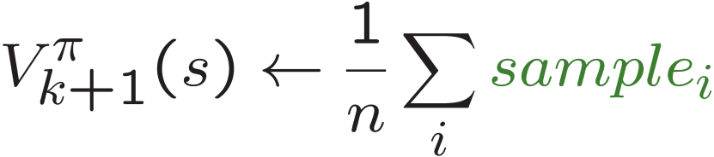
能否用基于样本的策略评价?
我们想改进对 V-值得估计，通过计算下面这些加权均值:
思想: 通过行动进行采样，得到结果状态 s’，然后进行均值
s
π(s)
s, π(s)
s, π(s),s’
s₁'
s₂'
s'
s₃'
Notes:
Almost! But we can’t rewind time to get sample after sample from the just past state s.

Slide 31
时间差分学习
Temporal Difference Learning
基本思想: 从每一次经验中学习!
  每经历一次状态过渡 (s, a, s’, r )，就更新一下 V(s)
  逐渐地，结果状态 s’将会越来越多地参与到更新过程中
V-值的时间差分学习
  固定的策略, 还是在做策略评价!
  把V值逐渐地向最终结果的值方向移动: 逐渐在计算均值
s
π(s)
s, π(s)
s’
Sample of V(s):
Update to V(s):
Same update:
Notes:
A way of Running average calculation. To calculate the averages of V values (state values) in a running way. Because you can’t rewind games’ states to do sampling as you wanted.

Slide 32
指数移动平均法
Exponential Moving Average
指数移动平均
  插值更新法:
  使最近的样本更重要
  逐渐遗忘过去的值(distant past values were wrong anyway)
（逐渐）降低学习参数(alpha)能够使该均值收敛
Notes:
Makes recent samples more important than previous ones.

Slide 33
举例: 时间差分学习法
States
Observed Transitions
B, east, C, -2
C, east, D, -2
 | A
B | C | D
 | E
 | 0
0 | 0 | 8
 | 0
 | 0
-1 | 0 | 8
 | 0
 | 0
-1 | 3 | 8
 | 0
Assume: γ = 1, α = 1/2
Notes:
The policy is fixed now. The 2nd picture shows current V-values. Updates took places in the following 3rd and 4th figures.
[blue expression] represents a sample value.
Questions to ask: watch B and C’s values, how they changed given negative transition rewards. One is going down, the other is going up. Why?

Slide 34
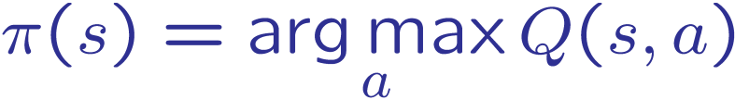
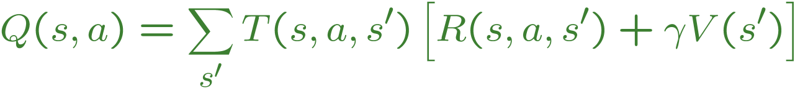
通过时间差分法学习到状态值以后怎么办？
时间差分状态值学习 是一种model-free方法进行策略评价.通过计算样本均值,模仿Bellman的更新，
然而, 如果想要把状态值转换为(新的)策略，就变得很难了:
想法: 学习 Q-值, 而不是V-值
从而使行动的选择变得也是model-free!
s
a
s, a
s,a,s’
s’
Notes:
Because of model-free, we don’t know T or R functions.

Slide 35
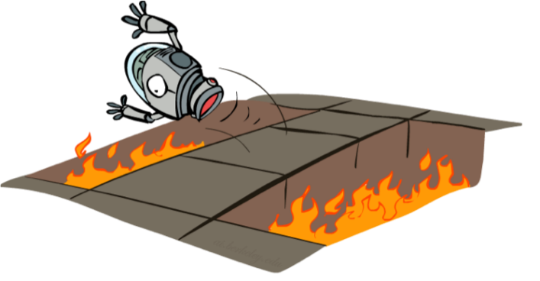
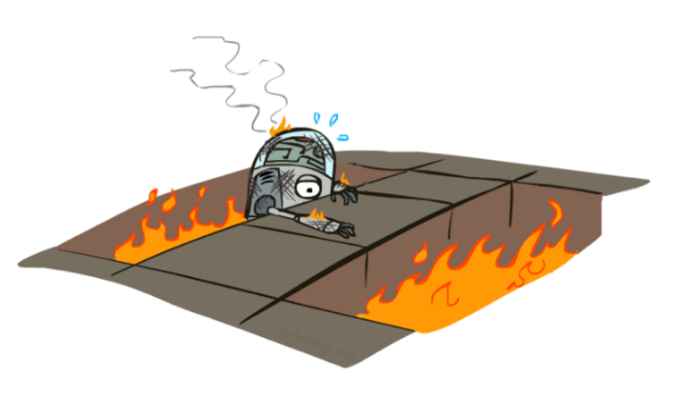
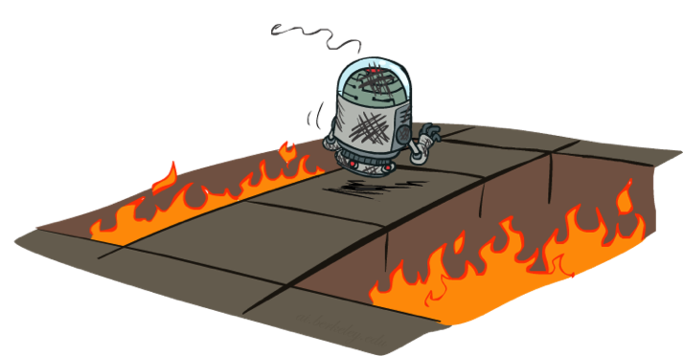
主动强化学习
Active Reinforcement Learning
Notes:
Try to learn the Q values this time.

Slide 36
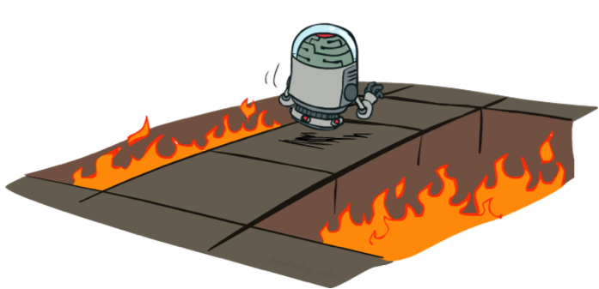
主动强化学习
完整的强化学习: 找到最优策略
  你不知道转移概率 T(s,a,s’)
  你不知道奖赏函数 R(s,a,s’)
  你现在可以自主选择行动
  目标: 学习最优策略 / 状态值
在这种情况下:
  智能体决定做什么(行动)!
  基本上的平衡制约: 探索 vs. 利用
  这并不是线下规划! You actually take actions in the world and find out what happens…
Notes:
Offline planning : build a model, and do offline computation of optimal action planning.
Exploration: try something new.

Slide 37
Q值迭代
先介绍一下: Q-Value Iteration
状态值迭代: 找到后继 (有限深度的) 值
  初始化 V₀(s) = 0, which we know is right
  给定 V_{k}, 计算深度为 k+1 的值 for all states:
但是 Q-值 更有用, 所以转而计算它们
  初始化 Q₀(s,a) = 0, which we know is right
  给定 Q_{k}, 计算深度为 k+1 的 q值 for all q-states:
Notes:
Max Q_k() part actually equals to V_k().
More samples, and take averages, the resulted Q values will eventually converges to its true values.
You don’t know the probability distribution, but we can take samples (samples are drawn explicitly from the distribution).

Slide 38

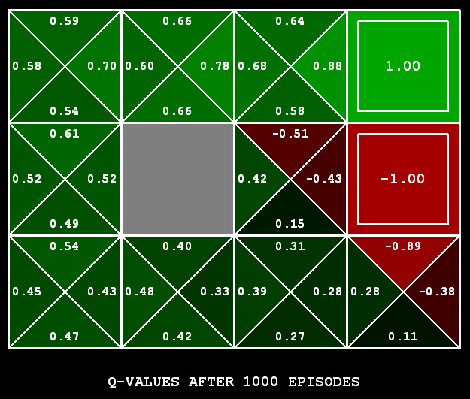
Q-值学习
Q-Learning
Q-Learning: 基于样本的 Q-值 迭代
学习 Q(s,a) 的值，在实践过程中
  获得一个样本 (s,a,s’,r)
  考虑你旧的估值:
  考虑你新的估值:
  把新的估值结合进来，计算实时均值更新:
Notes:
[Demo: Q-learning – gridworld (L10D2)]
[Demo: Q-learning – crawler (L10D3)] as following.

Slide 39
Notes:
Exercise for Q-value updates.

Slide 40
视频演示 Q-Learning -- Gridworld
Notes:
Note: there is no living reward in this case. Alpha=0.5
Q values learning looks for the max rewards, it won’t averages good and bad rewards in that direction’s Q state value.

Slide 41
视频演示 Q-Learning -- Crawler
Notes:
The two pictures show the angles (discretized boxes) of the motor joints(first and the second). Green color means good rewards, red color means bad rewards. The robot can change its angles of the motor joints.

Slide 42

Q-Learning 性质
好结果: Q-learning 收敛于最优策略 – 即便你在实践采样过程中行动是次优化的!
这叫做 没有策略的学习 off-policy learning
需要注意的:
  你不得不要探索充分
  你最终要调整learning rate 到足够小
  … 但也不能减小太快
  最终来讲, 学习过程中你如何选择行动无关紧要(!)

