Slide 1
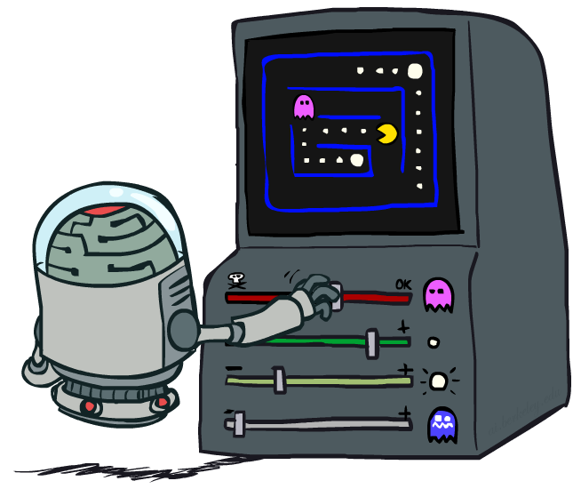
加强学习(reinforcement learning) II

Slide 2

加强学习
假定情景仍为一个 MDP:
一个 状态集合 s ∈ S
一个 行动集合 (每个状态) A
一个 转移模型 T(s,a,s’)
一个 奖赏值函数 R(s,a,s’)
依然是寻找一个策略 π(s)
不一样的地方是: 不知道 T 或 R, 所以必须去尝试不同的行动(获取相应的奖赏值)
Big idea: 利用(行动)样本结果来计算基于T的(Q状态)均值

Slide 3
从 MDPs 到 RL
已知 MDP: Offline Solution
Goal Technique
计算 V*, Q*, π* Value / policy iteration
评估一个给定的 π Policy evaluation
未知 MDP: Model-Free
未知 MDP: Model-Based
Goal Technique
计算 V*, Q*, π* VI/PI on approx. MDP
Evaluate a fixed policy π PE on approx. MDP
Goal Technique
计算 V*, Q*, π* Q-learning
Evaluate a fixed policy π Value Learning

Slide 4
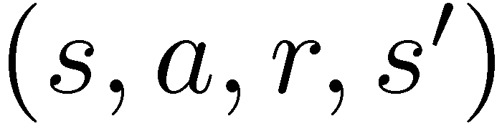
不基于模型的 Learning
Model-free (时间差分temporal difference) learning
Experience world through episodes
Update estimates each transition
反复更新最终模仿了 Bellman updates
s
a
s, a
r
s’
a’
s’, a’
s’’

Slide 5


Approximating Values through Samples
Policy Evaluation:
Value Iteration:
Q-Value Iteration:
Notes:
Value iteration can not be updated through samples, why, because it has a MAX operator at outer left side. Other cases, it can be estimated by running averages from samples.

Slide 6
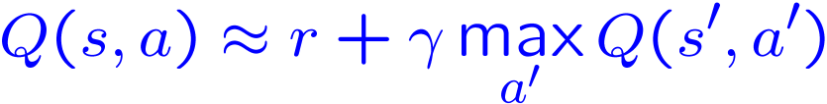
Q-Learning （Q-值学习）
对于每个Q状态，We’d like to do Q-value updates:
But can’t compute this update without knowing T, R
转而计算 均值 as we go
每获得一个 样本 transition (s,a,r,s’)
This sample suggests
But we want to average over results from (s,a) (Why?)
So keep a running average
Notes:
to the best of our approximation reward r will be followed by discounted future.
Alpha is the learning rate.

Slide 7

Q-Learning 属性
优势: Q-learning 收敛于最优（行动）策略 -- even if you’re acting suboptimally!
This is called off-policy learning
Caveats 缺点:
You have to explore enough
最终要使 learning rate 变得足够小
… 但是又不能让它减小的太快
Basically, in the limit, it doesn’t matter how you select actions (!)
[Demo: Q-learning – auto – cliff grid (L11D1)]

Slide 8

视频演示Q-Learning Auto Cliff Grid

Slide 9
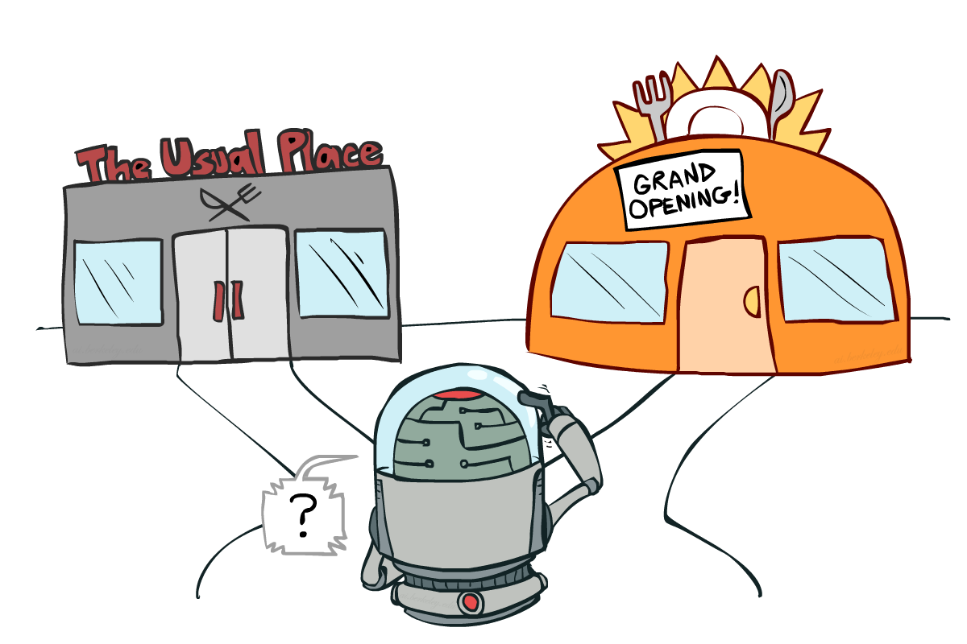
Exploration探索 vs. Exploitation利用

Slide 10

How to Explore?
几种方法用来执行 exploration
最简单的: 随机选择行动 (ε-greedy)
Every time step, flip a coin
With (small) probability ε, act randomly
With (large) probability 1-ε, act on current policy
随机选择行动的问题所在?
You do eventually explore the space, but keep thrashing around once learning is done
One solution: 逐渐减小 ε over time
Another solution: 使用探索函数 exploration functions
[Demo: Q-learning – manual exploration – bridge grid (L11D2)] [Demo: Q-learning – epsilon-greedy -- crawler (L11D3)]

Slide 11
视频演示Q-learning – Manual Exploration – Bridge Grid

Slide 12
视频演示 Q-learning – Epsilon-Greedy – Crawler

Slide 13
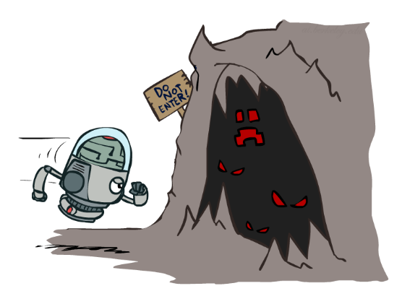

Exploration Functions探索函数
When to explore?
Random actions: explore a fixed amount
更好的想法: explore areas whose badness is not
(yet) established, eventually stop exploring
Exploration function 探索函数
两个输入，一个是估计的Q值 u，另一个是 访问Q状态的次数 n, and
returns an optimistic utility, e.g.
Note: this propagates the “bonus” back to states that lead to unknown states as well!
Regular Q-Update:
修改的 Q-Update:
[Demo: exploration – Q-learning – crawler – exploration function (L11D4)]
Notes:
Exploration function incorporates exploring potential in which state s’ there are not many actions have been taken yet.
K is a constant.

Slide 14
视频演示Q-learning – 探索函数 – Crawler

Slide 15
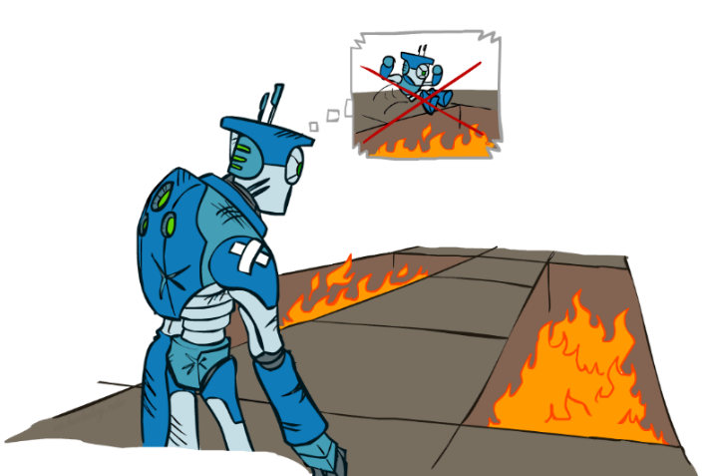
Regret
在学习最优策略的过程中，会犯错误（选错行动，导致不好的结果）
Regret 是一个衡量对于你的机器人所犯错误导致的代价之和: 你的期望奖励值之差值，即你所获得的奖励值和最优奖励值的差值
最小化 regret 本身涉及到学习优化策略以外的事 – 需要你的学习方法（算法）本身也是最优化的
例如: 随机探索算法random exploration 和 利用探索函数exploration functions的算法，都可以找到最优行动策略, 但是前者有更大的 regret

Slide 16
Approximate Q-Learning
Notes:
Dealing with a big state space. There are so many states, that you can’t learn each of them.

Slide 17

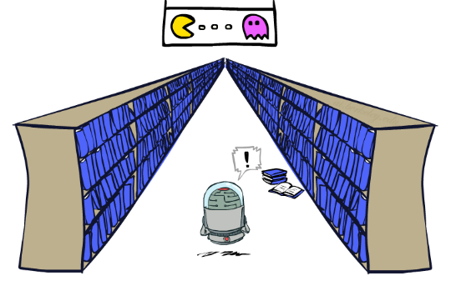
Generalizing Across States（泛化状态）
Basic Q-Learning keeps a table of all q-values
在现实情境中, 不可能学习关于每个状态!
Too many states to visit them all in training
Too many states to hold the q-tables in memory
转而, we want to generalize:
Learn about some small number of training states from experience
Generalize that experience to new, similar situations
This is a fundamental idea in machine learning, and we’ll see it over and over again
[demo – RL pacman]
Notes:
If too many state and actions, you can’t learn them all, and even not be able to put them in memory.
Infinite library, can’t really learn it out.

Slide 18
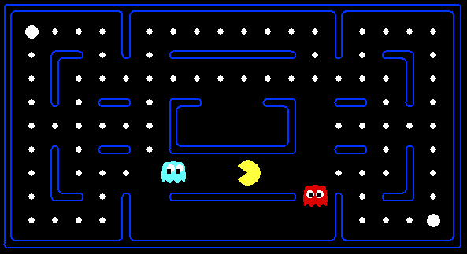



Example: Pacman
假设我们通过经验发现这个状态是槽糕的:
In naïve q-learning, we know nothing about this state:
Or even this one!
[Demo: Q-learning – pacman – tiny – watch all (L11D5)]
[Demo: Q-learning – pacman – tiny – silent train (L11D6)]
[Demo: Q-learning – pacman – tricky – watch all (L11D7)]
Notes:
The difference between the first and the third ones is the one pea upper right less in the third one. These two situations would give similar learning experience, but pacman training program may think they are totally different states.

Slide 19
视频演示Q-Learning Pacman – Tiny – Watch All
Notes:
Original Q-learning, most losses because initially Q values are not good. Doesn’t learn too quickly.

Slide 20
视频演示Q-Learning Pacman – Tiny – Silent Train
Notes:
Q-learning took a lots of iterations even in this tiny world of example. After two thousands of episodes, we watch it again.
Only 6 positions, and 1 food point. But took many iterations to train.

Slide 21
视频演示Q-Learning Pacman – Tricky – Watch All
Notes:
Still original Q learning.
To want to generalize states situations, in order to make a faster learning.

Slide 22
基于特征的状态表达
Solution: describe a state using a vector of features (properties) 使用特征向量
Features are functions from states to real numbers (often 0/1) that capture important properties of the state
Example features:
Distance to closest ghost
Distance to closest dot
Number of ghosts
1 / (dist to dot)²
Is Pacman in a tunnel? (0/1)
…… etc.
Is it the exact state on this slide?
Can also describe a q-state (s, a) with features (e.g. action moves closer to food)
Notes:
We have seen using features appeared in adversarial searching for mini-max search to evaluate some depth’s states.

Slide 23
特征值的线性拟合
Using a feature representation, we can write a q function (or value function) for any state using a few weights:
优势: our experience is summed up in a few powerful numbers
劣势: states may share features but actually be very different in value!
Notes:
Weights not known here yet. Needs to be learned.
Pro: this way can generalize the learning to states we have not seen.

Slide 24
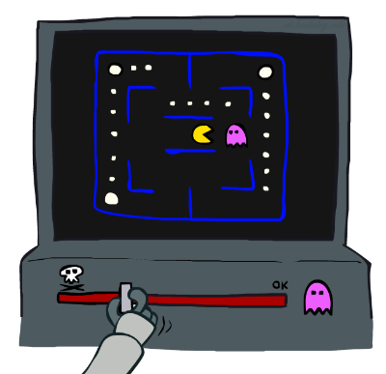
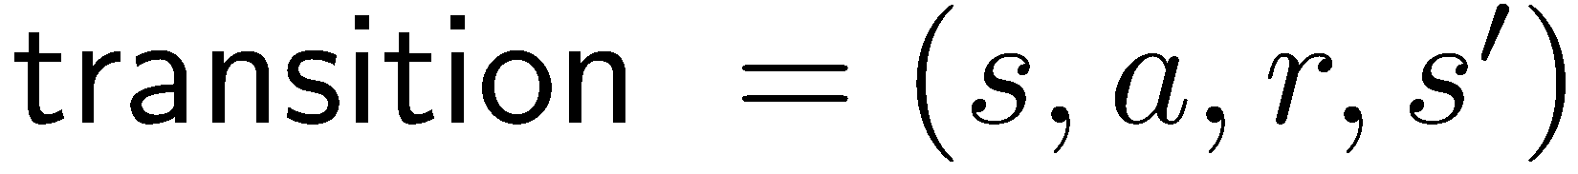
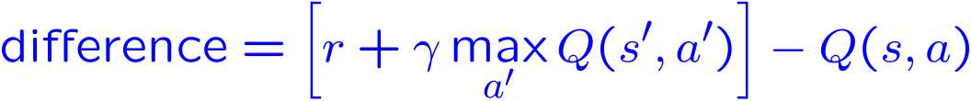
Approximate 近似 Q-Learning
Q-learning with linear Q-functions:
简单的解释:
调整激活的特征值的权重
E.g., if something unexpectedly bad happens, blame the features that were on: disprefer all states with that state’s features
Formal justification: online least squares 在线最小二值法
Exact Q’s
Approximate Q’s
Notes:
这里实际上要学习每个特征函数对应的权值。

Slide 25
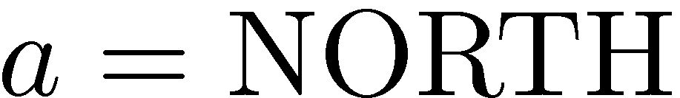
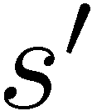

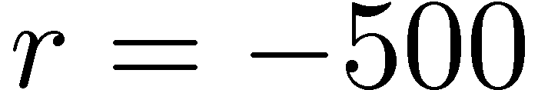


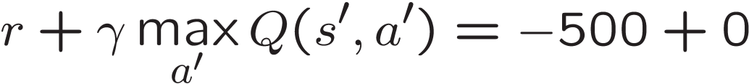
举例: Q-Pacman
[Demo: approximate Q-learning pacman (L11D10)]
Notes:
Initialized like this as in the first Q expression.
DOT: close to a dot feature; GST: close to a ghost feature.
Result of weights updating is now that we still like dots, but we really don’t like ghosts.

Slide 26
视频演示Approximate Q-Learning -- Pacman
Notes:
10 episodes so far, and it already played very well.

Slide 27
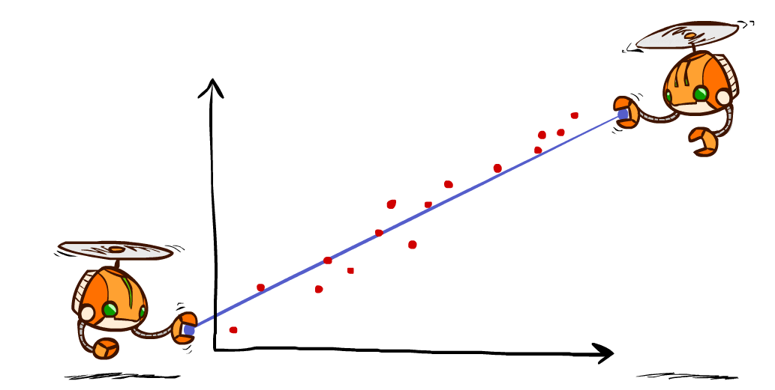
Q-Learning and Least Squares

Slide 28

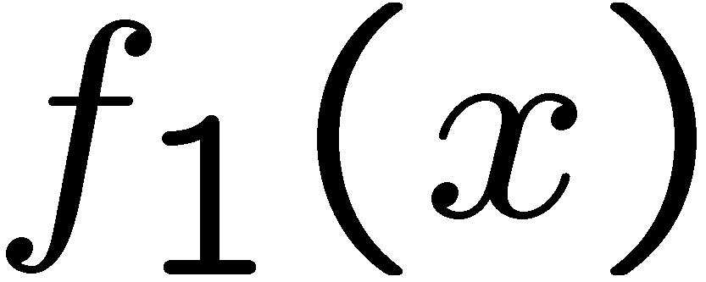
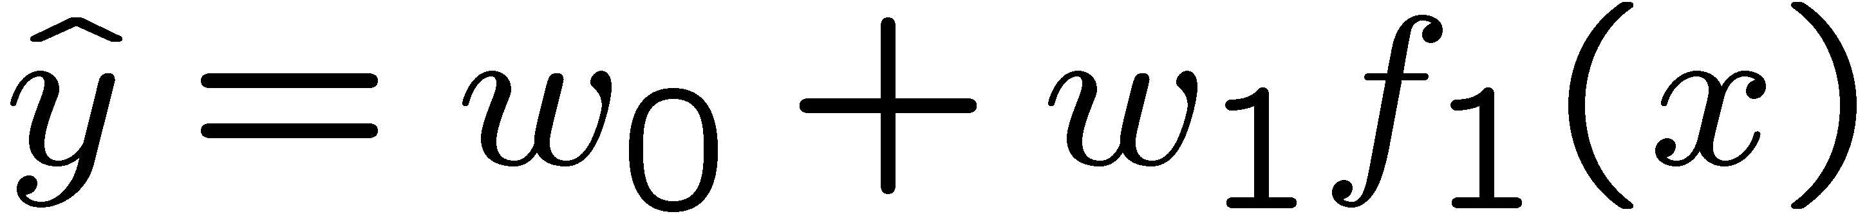
Linear Approximation: Regression*
40
26
24
20
22
20
30
20
40
0
30
0
20
10
20
0
10
0
Prediction:
Prediction:
Notes:
Figure 1: scatter(1:20,10+(1:20)+2*randn(1,20),'k','filled'); a=axis; a(3)=0; axis(a);

Slide 29
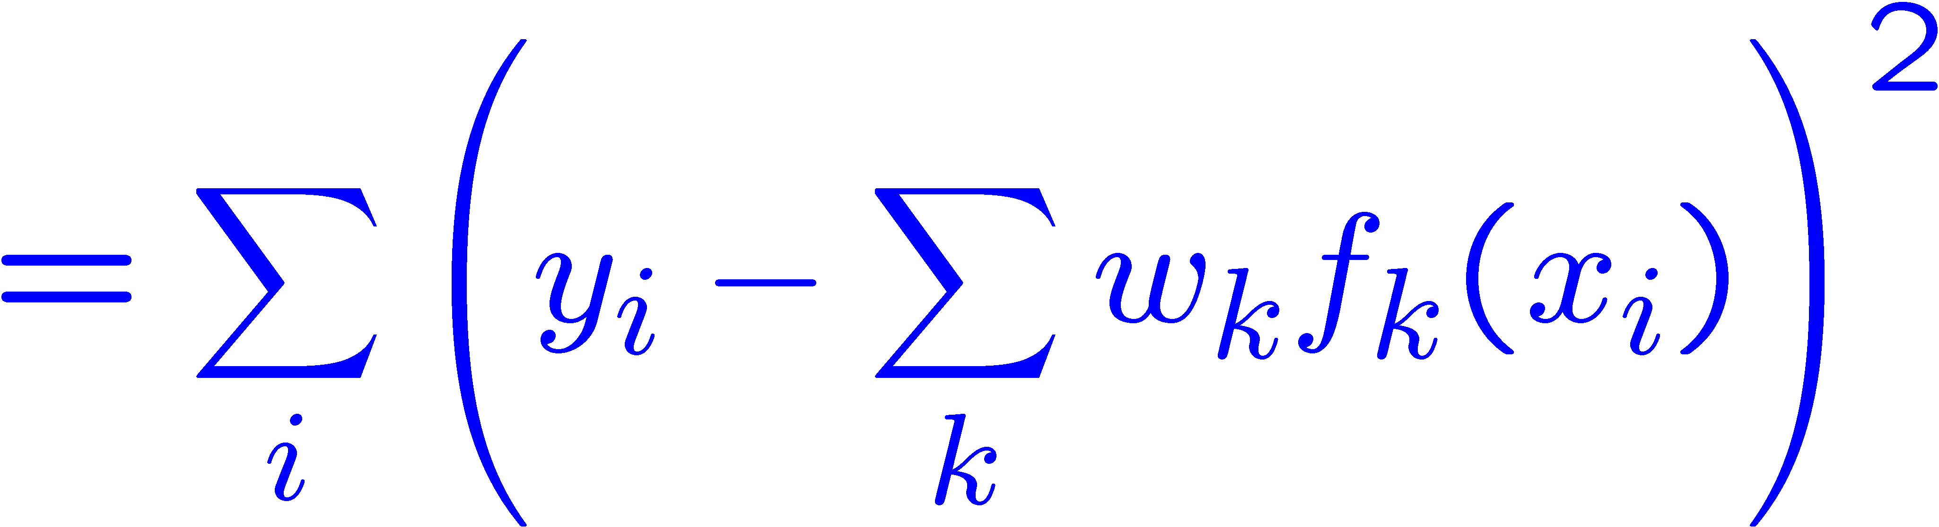
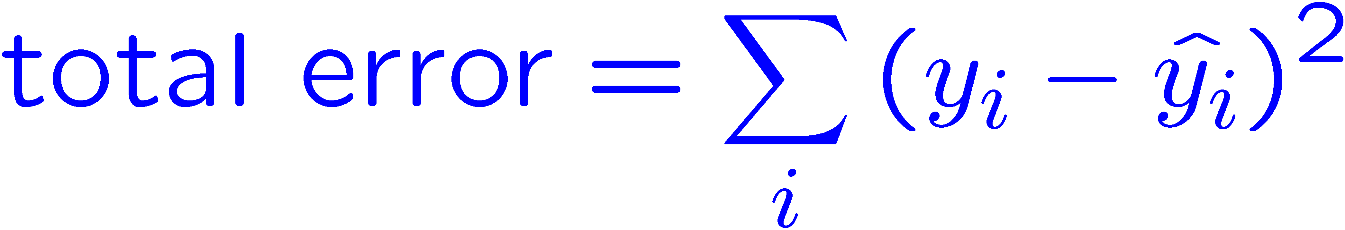
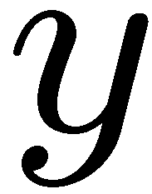


Optimization: Least Squares*
Error or “residual”
Observation
Prediction
0
0
20
Notes:
Figure 1: scatter(1:20,10+(1:20)+2*randn(1,20),'k','filled'); a=axis; a(3)=0; axis(a);

Slide 30
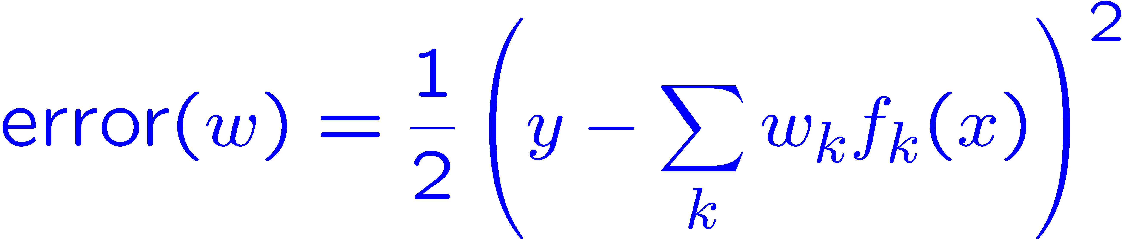

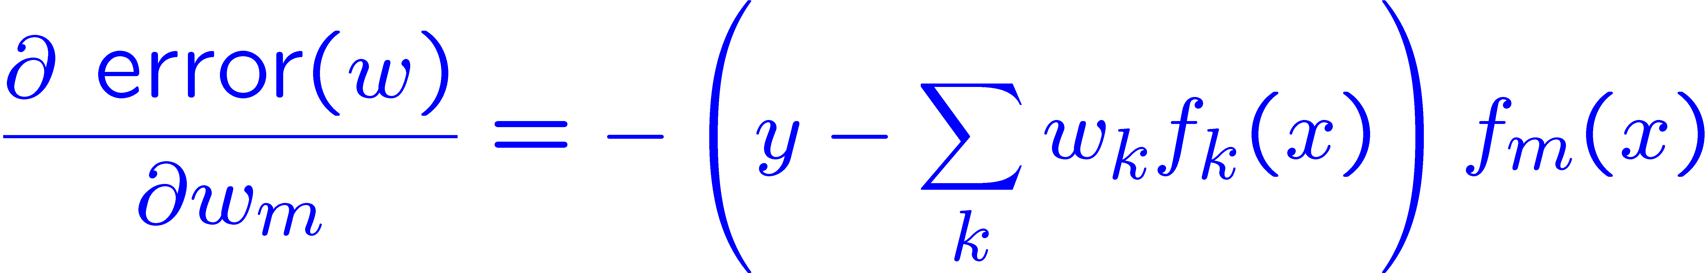
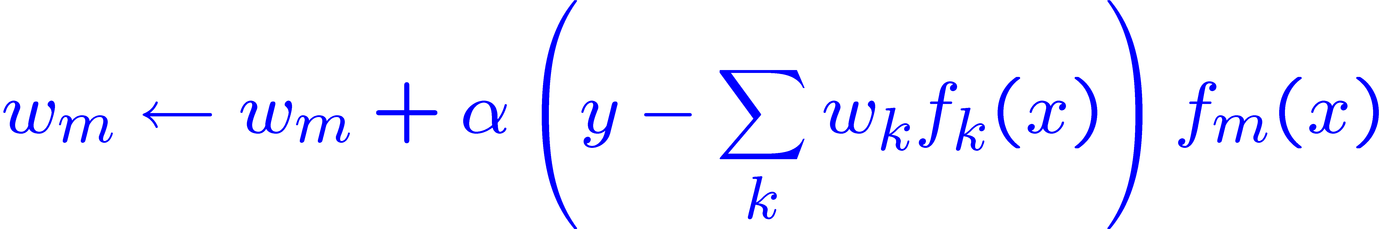
Minimizing Error*
Imagine we had only one point x, with features f(x), target value y, and weights w:
Approximate q update explained:
“target”
“prediction”
Notes:
Actually a gradient descent based update rule.
Like a stochastic gradient descent method.

Slide 31
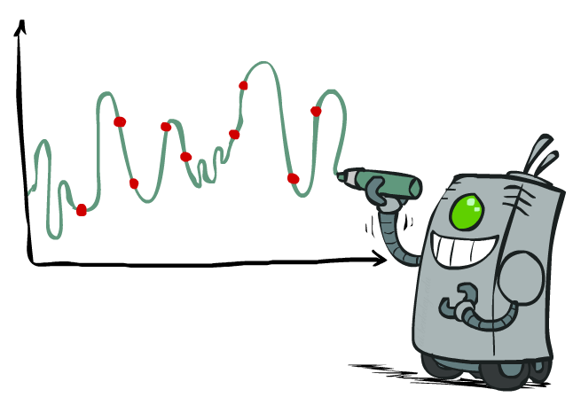
Overfitting: Why Limiting Capacity Can Help*
30
25
20
Degree 15 polynomial
15
10
5
0
-5
-10
-15
0
2
4
6
8
10
12
14
16
18
20
Notes:
If you want to generalize, then you don’t want to overfit. So you have to limit capacity of your model.

Slide 32

Policy Search
Notes:
You try directly to improve policy.

Slide 33
Policy Search
Problem: often the feature-based policies that work well (win games, maximize utilities) aren’t the ones that approximate V / Q best
E.g. your value functions from project 2 were probably horrible estimates of future rewards, but they still produced good decisions
Q-learning’s priority: get Q-values close (modeling)
Action selection priority: get ordering of Q-values right (prediction)
We’ll see this distinction between modeling and prediction again later in the course
Solution: learn policies that maximize rewards, not the values that predict them
Policy search: start with an ok solution (e.g. Q-learning) then fine-tune by hill climbing on feature weights

Slide 34
Policy Search
Simplest policy search:
Start with an initial linear value function or Q-function
Nudge each feature weight up and down and see if your policy is better than before
Problems:
How do we tell the policy got better?
Need to run many sample episodes!
If there are a lot of features, this can be impractical
Better methods exploit lookahead structure, sample wisely, change multiple parameters…

Slide 35

Conclusion
We’re done with Part I: Search and Planning!
We’ve seen how AI methods can solve problems in:
Search
Constraint Satisfaction Problems
Games
Markov Decision Problems
Reinforcement Learning
Next up: Part II: Uncertainty and Learning!
Notes:
Searching and planning with bit of learning.

