Slide 1
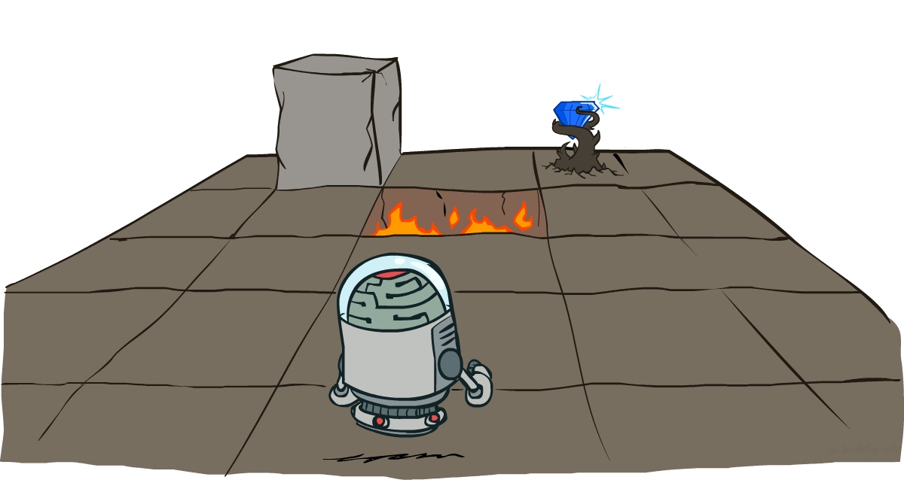
人工智能导论
马可夫决策过程
Markov Decision Processes

Slide 2
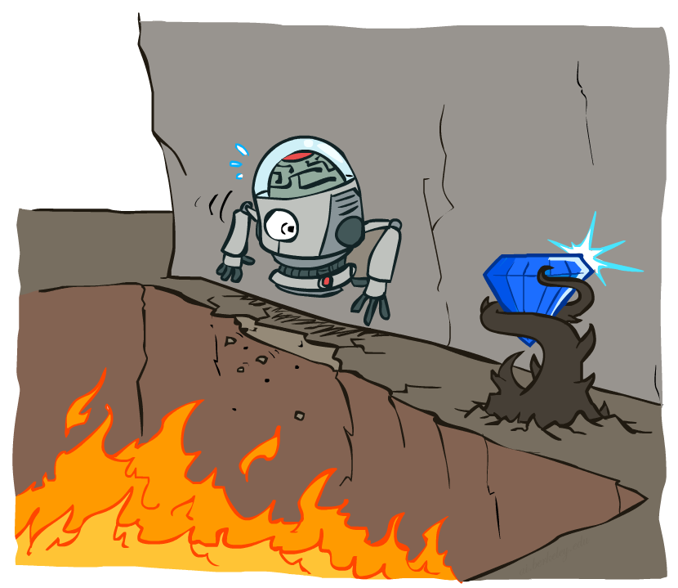
非确定性搜索
Non-Deterministic Search

Slide 3
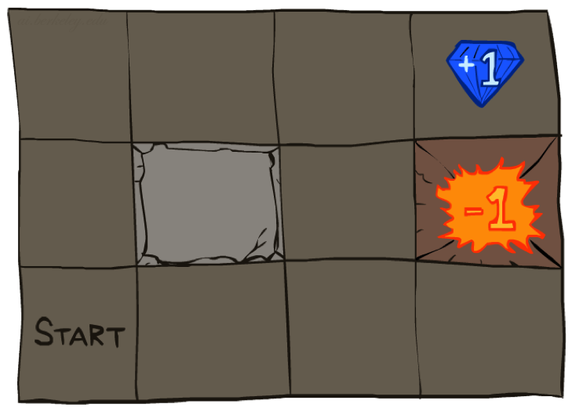




举例: Grid World
一个像迷宫的问题
粗糙的行动: 行动不总是获得预先计划的结果
智能体会在每个时刻获得奖赏（得分）
  每时刻步长，少量的 “生存 living reward” 奖赏 (也可能是负值)
  最大的奖赏分值在最后时刻（执行退出行动时） (可能是奖赏也可能是惩罚)
目标: 最大化总的奖赏得分
Notes:
A maze-like problem
The agent lives in a grid
Walls block the agent’s path
Noisy movement: actions do not always go as planned
80% of the time, the action North takes the agent North
(if there is no wall there)
10% of the time, North takes the agent West; 10% East
If there is a wall in the direction the agent would have been taken, the agent stays put

Slide 4

Video of Demo Gridworld Manual Intro

Slide 5
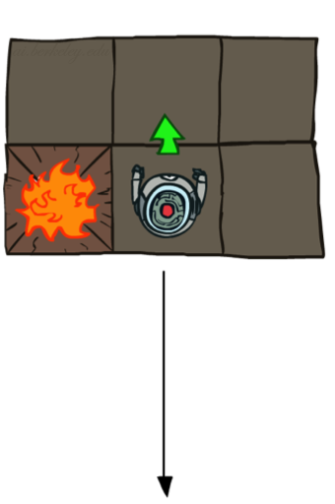
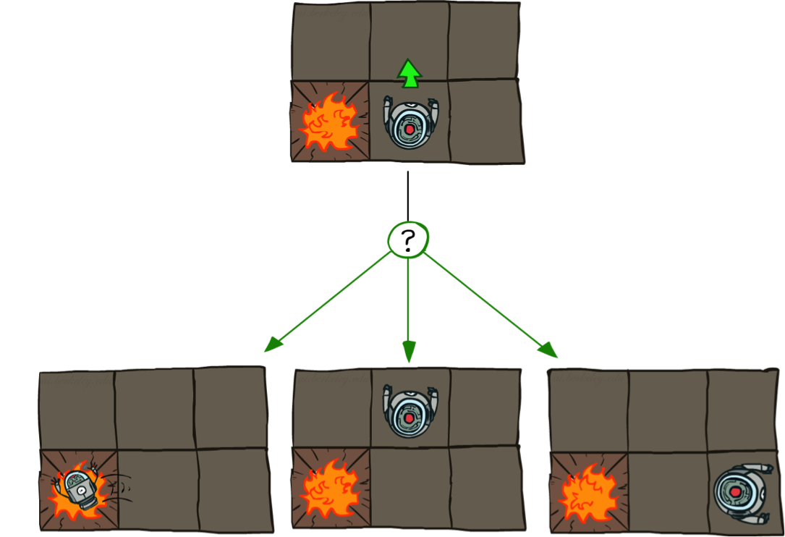
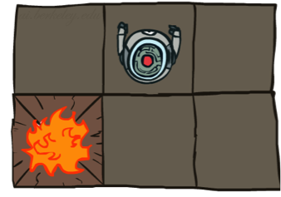
Grid World 行动
确定的 Grid World
随机的(不确定的) Grid World
Notes:
Probs: 80%, 10%, 10%.

Slide 6
马可夫决策过程(MDP)
一个MDP 由以下定义:
  状态集合 s ∈ S
  行动集合 a ∈ A
  转移函数 T(s, a, s’)
    从状态 s 采取行动 a 到达 s’的概率, 即 P(s’| s, a)
    也叫做动态模型
  奖赏函数 R(s, a, s’)
    有时只是 R(s) or R(s’)
  一个开始状态
  一个终点状态 （有可能）
MDPs 是非确定性搜索问题
  一种求解方法是通过期望最大值搜索
  我们将看到其他的求解方法
Notes:
In search problems: did not talk about actions, but about successor functions --- now the information inside the successor function is unpacked into actions, transitions and reward
Write out S, A, example entry in T, entry in R
Reward function different from the book : R(s,a,s’)
In book simpler for equations, but not useful for the projects.
Need to modify expectimax a tiny little bit to account for rewards along the way, but that’s something you should be able to do, and so you can already solve MDP’s (not in most efficient way)

Slide 7
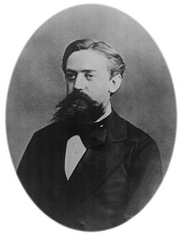

MDPs中的马可夫性质
“Markov” 通常意味着给定当前状态, 未来状态独立于过去状态
对于马可夫决策过程, “Markov” 的含义是行动的输出结果只取决于当前状态
就像在搜索问题里, 后继函数只依赖于当前的搜索状态 (而不是历史状态)
Andrey Markov (1856-1922)
Notes:
Like search: successor function only depended on current state
Can make this happen by stuffing more into the state;
Very similar to search problems: when solving a maze with food pellets, we stored which food pellets were eaten

Slide 8
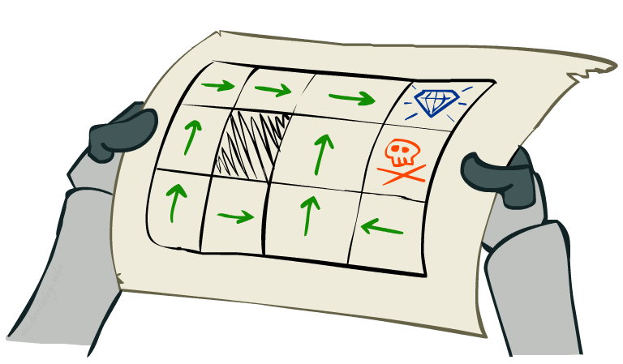
策略 Policies
在确定性的，单一智能体的，搜索问题里， 我们想获得一个最优的 规划 plan, 或是一个从开始到目标状态的行动上的序列
对于 MDPs, 我们想获得的是一个最优的 策略 policy π*: S → A
  一个策略 π 对于每个状态给出了一个行动
  一个最优策略是这样一个策略，即遵循它可以获得最大化期望功效值
  一个明示的策略定义了一个反射型的智能体
Notes:
Optimal policy when R(s, a, s’) = -0.03 for all non-terminals s
Dan has a DEMO for this.

Slide 9
Optimal Policies
R(s) = -0.01
R(s) = -0.03
R(s) = -0.4
R(s) = -2.0
Notes:
R(s) = the “living reward”
The living reward going from small to big, then the policies change (from risk-avoider to risk-taker).

Slide 10
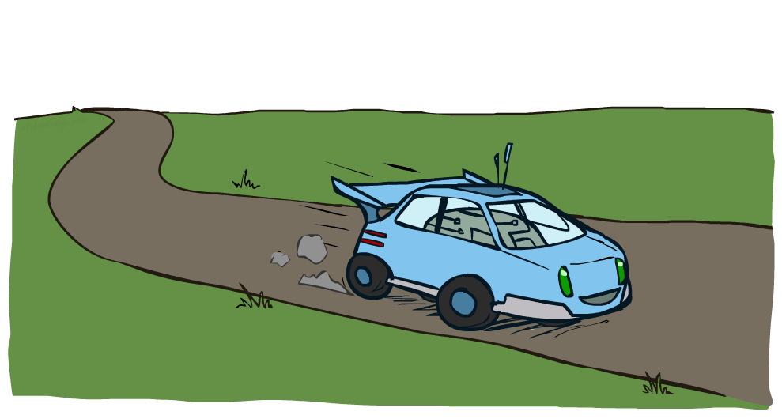
举例: 赛车

Slide 11
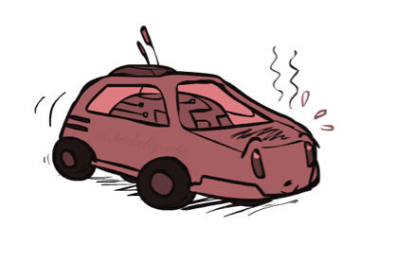
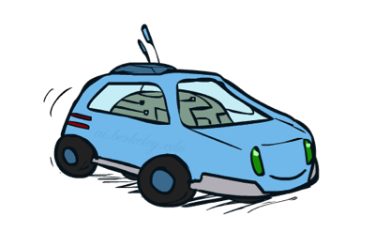
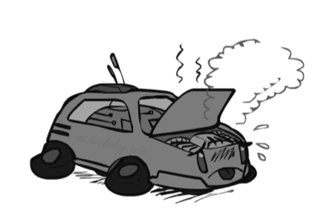
举例: 赛车
一个机器人汽车想要开的既远又快
三个状态: Cool, Warm, Overheated
两个行动: Slow, Fast
速度快可以得到双倍的奖赏
0.5
+1
Fast
1.0
Slow
-10
+1
0.5
Warm
Slow
Fast
0.5
+2
Cool
0.5
Overheated
1.0
+1
+2

Slide 12
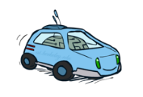
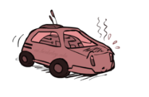

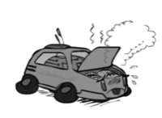
赛车例子里的搜索树

Slide 13
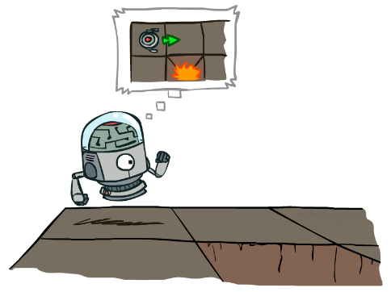

MDP 搜索树
一个 类似-期望最大的 搜索树
s
s is a state
a
(s, a) is a q-state
s, a
(s,a,s’)
T(s,a,s’) = P(s’|s,a)
R(s,a,s’)
s,a,s’
s’
Notes:
In MDP chance node represents uncertainty about what might happen based on (s,a) [as opposed to being a random adversary]
Q-state (s,a) is when you were in a state and took an action
(s,a,s’) called a transition
T(s,a,s’) = P(s’|s,a)
R(s,a,s’) : Rewards

Slide 14
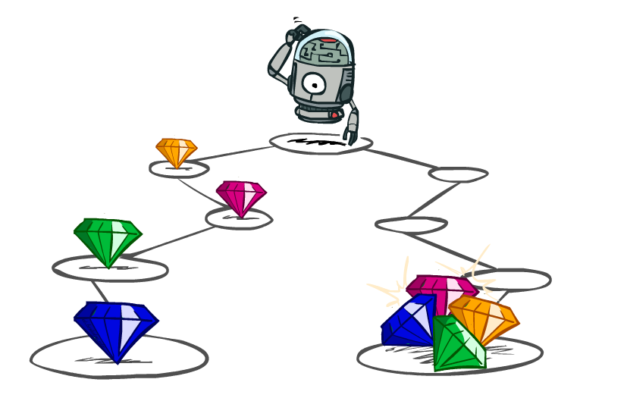
不同奖赏值序列的选择
Notes:
R(s,a,s’) : Rewards

Slide 15
如何选择：不同的奖赏值序列
不同选择的偏好，智能体应如何选择?
多或是少?
现在或是以后?
[1, 2, 2]
or
[2, 3, 4]
[0, 0, 1]
or
[1, 0, 0]

Slide 16

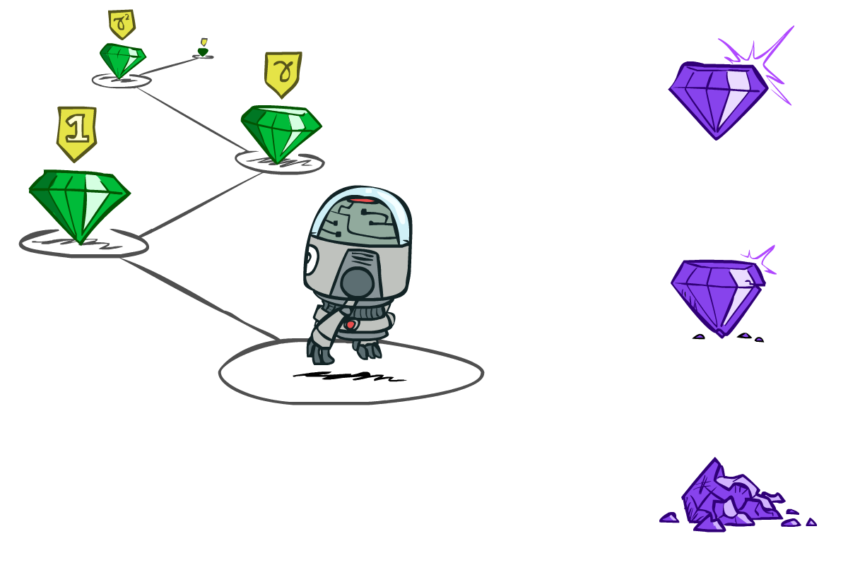

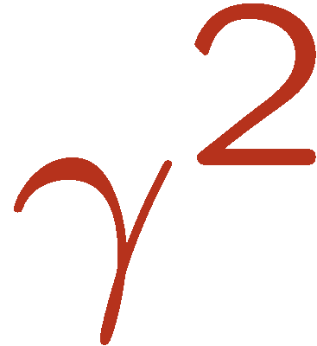

奖赏的折扣 Discounting
最大化奖赏值的总和
同时，趋向于越早获得奖赏越好
一种方法是: 奖赏值随时间成指数递减
现在的价值
下一步的
两步以后的
Notes:
如果不加折扣，可以一直徘徊在游戏里，从而分值会不断增加。

Slide 17

折扣的奖赏
如何打折?
  在搜索树上每下降一层，乘上一次折扣系数
为什么要进行折扣?
  为了实现倾向于更早地获得奖赏
  还能帮助算法收敛
例如: 折扣系数 0.5
  U([1,2,3]) = 1*1 + 0.5*2 + 0.25*3
  U([1,2,3]) < U([3,2,1])
Notes:
Rewards in the future (deeper in the tree) matter less
Interesting: running expectimax, if having to truncate the search, then not losing much; e.g., less then \gamma^d / (1-\gamma)

Slide 18
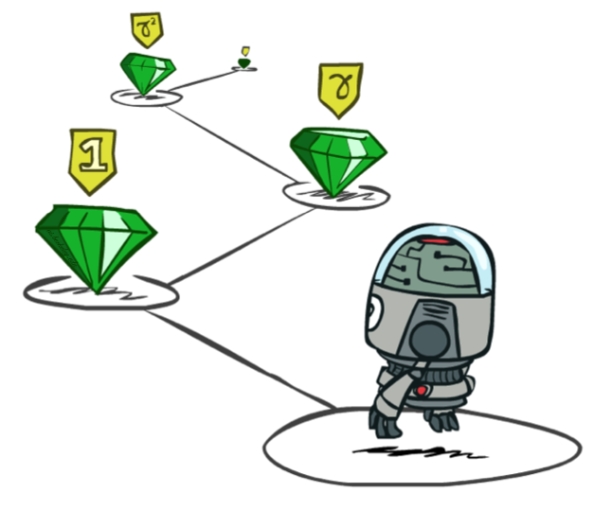
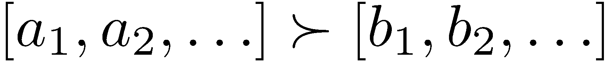
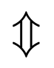
稳定的优先权
Stationary Preferences
定理: 如果我们假设 稳定的优先权:
那么: 只有两种方式定义其上的功效值 (utilities)
  相加功效值:
  折扣的功效值:
Notes:
Shift one time slot.

Slide 19


练习: 折扣的功效值
给定:
  行动: 向东走, 向西走, 和 退出 (退出行动只在退出状态 a, e上有效)
  状态转移: 确定性的
Quiz 1: For γ = 1, 最优策略是什么?
Quiz 2: For γ = 0.1, 最优策略?
Quiz 3: γ 为何值时，在状态d上，向西和向东的行动是一样好的？
Notes:
Quiz.

Slide 20
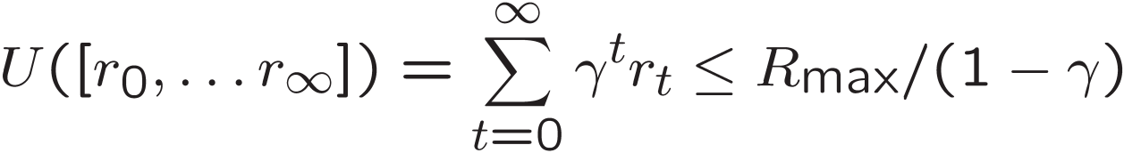
无穷大功效值?!
问题: 如果游戏一直进行下去会怎么样? 是否我们会得到无穷大的奖赏值?
解决方法:
  有限的游戏时间: (类似于有限深度的搜索)
    游戏终止在一个固定的 T 步长时间后
    使用非稳定的策略 (π 依赖于所剩游戏时间)
  折扣的奖赏: 使用 0 < γ < 1
  吸收状态: 对于每一个策略都保证, 一个终点状态将会被最终达到 (像在之前赛车例子里的 “overheated”状态)
Notes:
If there is no terminal states or no discounting, then it will keep collecting rewards, goes infinite rewards therefore infinite utility.
Rmax is the maximal reward ever in the game.
Smaller γ means smaller “horizon” – shorter term focus

Slide 21
重温一下: MDPs的定义
马可夫决策过程:
  状态集合 S
  开始状态 s₀
  行动集合 A
  转移模型 P(s’|s,a) (或 T(s,a,s’))
  奖赏函数 R(s,a,s’) (和 折扣 γ)
MDP 到目前为止所涉及的数量计算：
  策略 Policy = 对于每个给定状态的行动选择
  功效值 Utility = (折扣的) 奖赏值 之和
s
a
s, a
s,a,s’
s’
Notes:
A (stationary, deterministic) Policy pi : S -> A maps each state to an action.

Slide 22
求解 MDPs

Slide 23


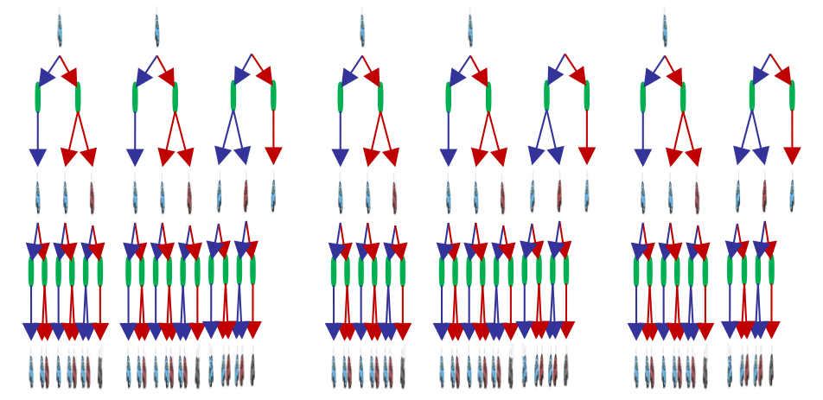

Racing Search Tree
We’re doing way too much work with expectimax!
Problem: States are repeated
  Idea: Only compute needed quantities once
Problem: Tree goes on forever
  Idea: Do a depth-limited computation, but with increasing depths until change is small
  Note: deep parts of the tree eventually don’t matter if γ < 1

Slide 24
定义最优量值
一个状态 s 的(功效)值:
  V*(s) = 开始于状态s然后随后都采取最优化行动，最后获得的期望功效值
一个 q-状态 (s,a)的(功效)值:
  Q*(s,a) = 开始于状态s并采取行动a,随后都采取最优化行动，最后获得的期望功效值
最优策略:
  π*(s) =给定状态 s，返回最优的行动
s is a state
s
a
(s, a) is a q-state
s, a
s,a,s’
(s,a,s’) is a
transition
s’
Notes:
Given Q values, what’s the optimal policy, it can be calculated out of Q values.

Slide 25
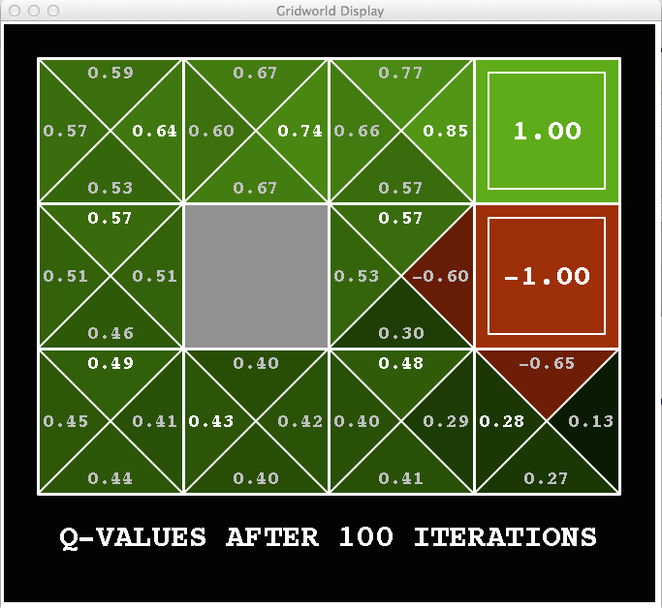
Snapshot of Gridworld - Q Values
Noise = 0.2
Discount = 0.9
Living reward = 0
Notes:
Q-state values.
Q values each state position with four actions (going four directions).
From here we can actually infer the current optimal policy (optimal action for each state at current step).
Optimal policy shown by the arrows.

Slide 26
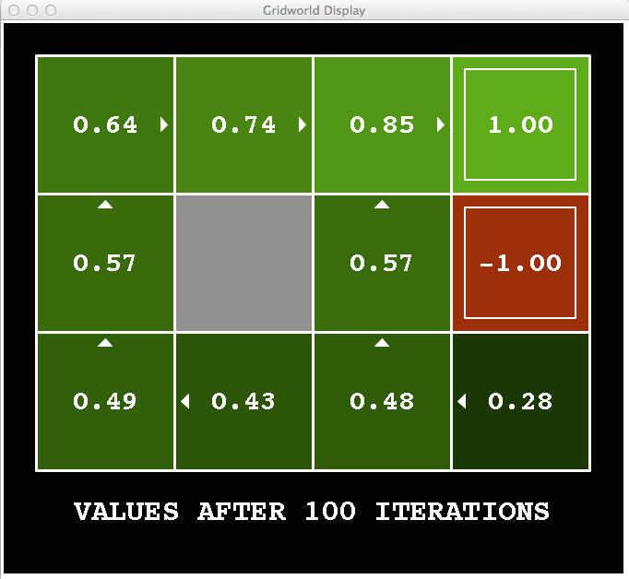
Snapshot of Gridworld - V Values
Noise = 0.2
Discount = 0.9
Living reward = 0
Notes:
Optimal value of state.
Arrows converges much earlier.

Slide 27

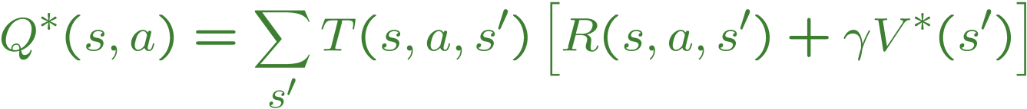
计算两种状态的值
基本操作: 计算一个状态的 (期望最大) 值
递归定义:
s
a
s, a
s,a,s’
s’
Notes:
基本操作: 计算一个状态的 (期望最大) 值
Expected utility under optimal action
Average sum of (discounted) rewards
This is just what expectimax computed!
The last recursive equation is called the bellman equation.

Slide 28

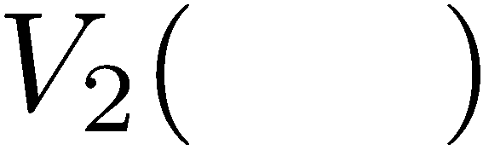


有限时间步长下的V值
Key idea: 限制时间步长
Define V_{k}(s) 状态s的最优值，如果游戏在K步长后结束
  相当于 it’s what a depth-k expectimax would give from s
Notes:
A dynamic programming approach.
V_k(s) actually means the (optimal) value of state s after k time steps.
This demo generates the time-limited values for gridworld as snapshotted onto the next slides.

Slide 29
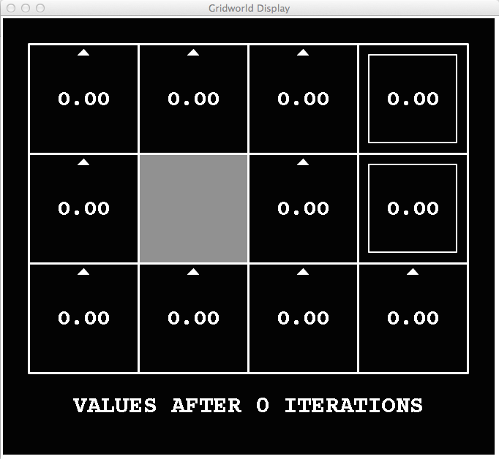
k=0
Noise = 0.2
Discount = 0.9
Living reward = 0
Notes:
Assuming zero living reward
Show the cases of value iteration.

Slide 30
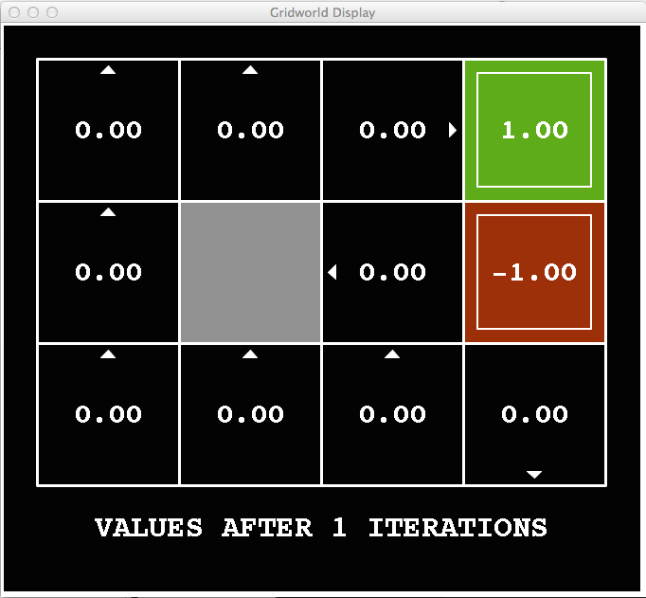
k=1
Noise = 0.2
Discount = 0.9
Living reward = 0
Notes:
Assuming zero living reward

Slide 31
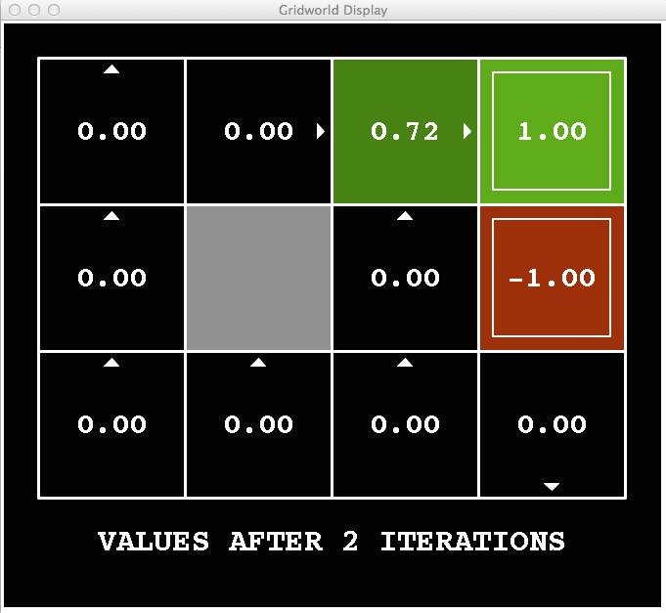
k=2
Noise = 0.2
Discount = 0.9
Living reward = 0
Notes:
Assuming zero living reward

Slide 32
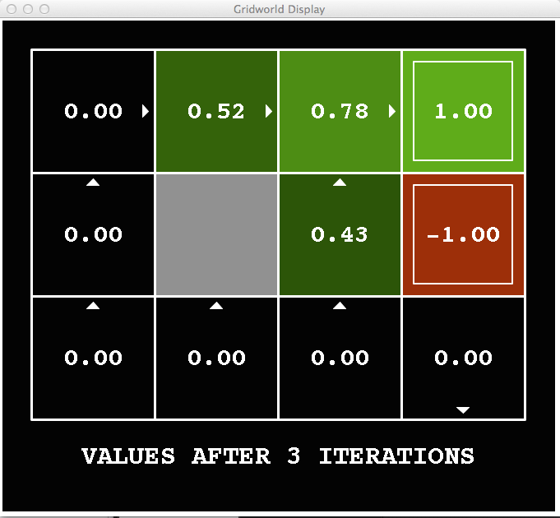
k=3
Noise = 0.2
Discount = 0.9
Living reward = 0
Notes:
Assuming zero living reward

Slide 33
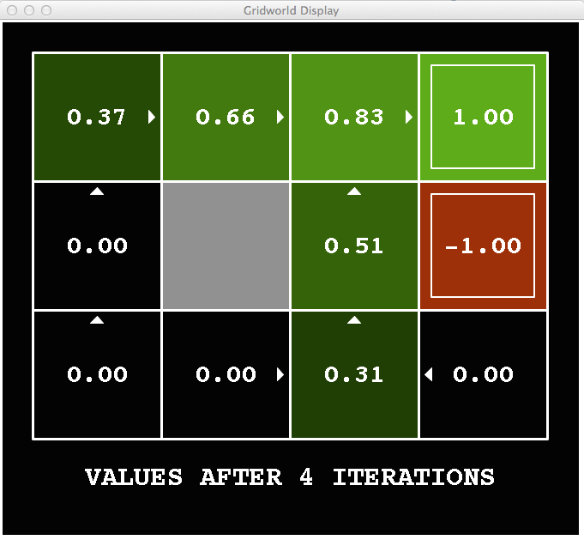
k=4
Noise = 0.2
Discount = 0.9
Living reward = 0
Notes:
Assuming zero living reward

Slide 34
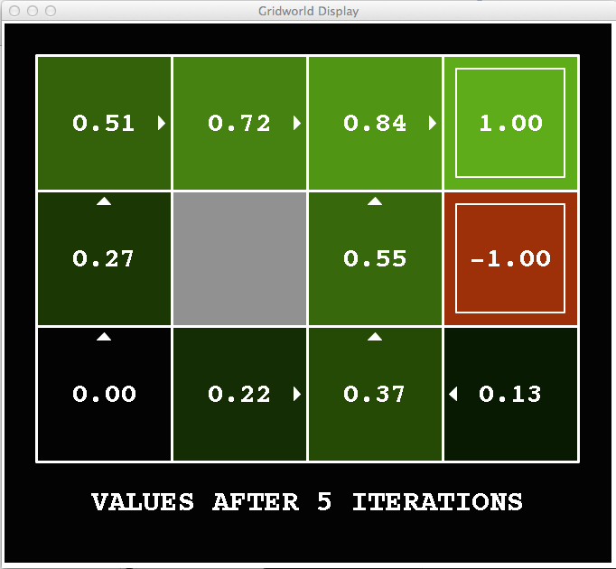
k=5
Noise = 0.2
Discount = 0.9
Living reward = 0
Notes:
Assuming zero living reward

Slide 35
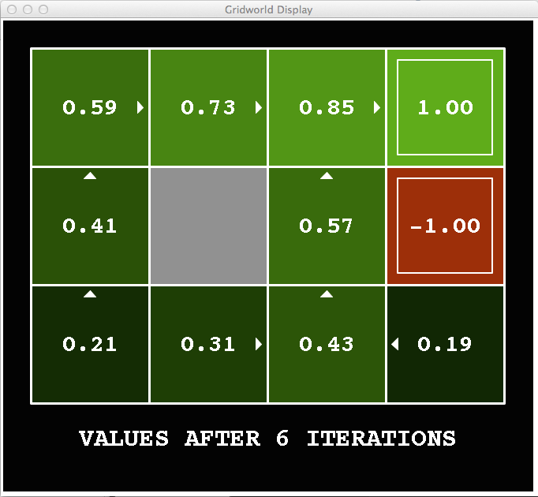
k=6
Noise = 0.2
Discount = 0.9
Living reward = 0
Notes:
Assuming zero living reward

Slide 36
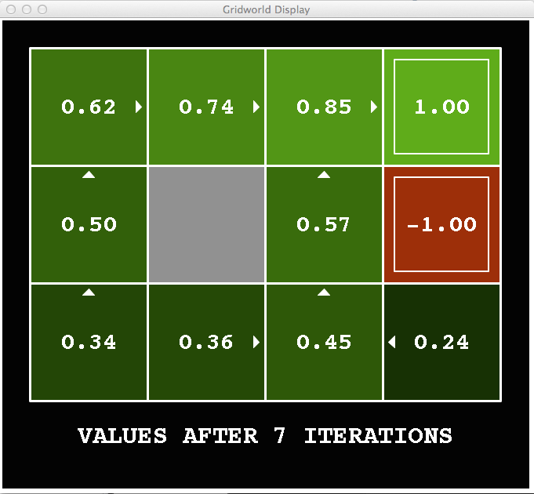
k=7
Noise = 0.2
Discount = 0.9
Living reward = 0
Notes:
Assuming zero living reward

Slide 37
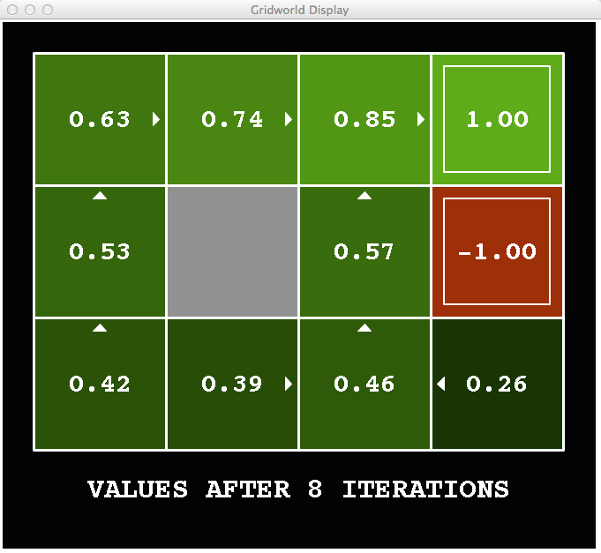
k=8
Noise = 0.2
Discount = 0.9
Living reward = 0
Notes:
Assuming zero living reward

Slide 38
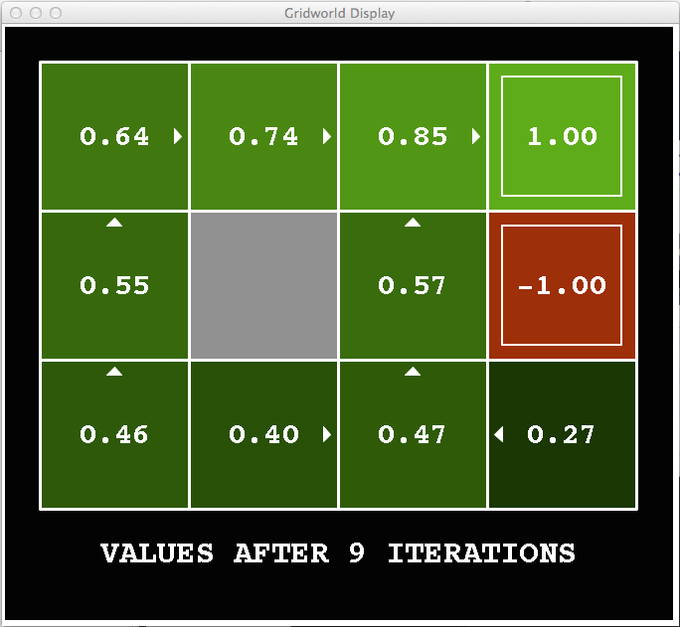
k=9
Noise = 0.2
Discount = 0.9
Living reward = 0
Notes:
Assuming zero living reward

Slide 39

k=10
Noise = 0.2
Discount = 0.9
Living reward = 0
Notes:
Assuming zero living reward

Slide 40

k=11
Noise = 0.2
Discount = 0.9
Living reward = 0
Notes:
Assuming zero living reward

Slide 41

k=12
Noise = 0.2
Discount = 0.9
Living reward = 0
Notes:
Assuming zero living reward

Slide 42

k=100
Noise = 0.2
Discount = 0.9
Living reward = 0
Notes:
Assuming zero living reward
Note: Action (by arrows) actually converged much faster or earlier than values.

Slide 43
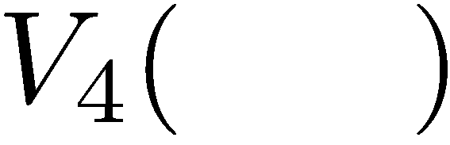

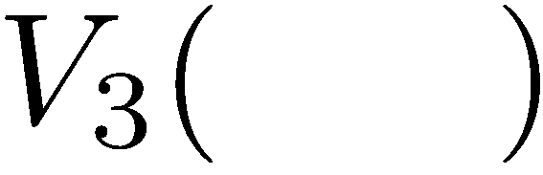
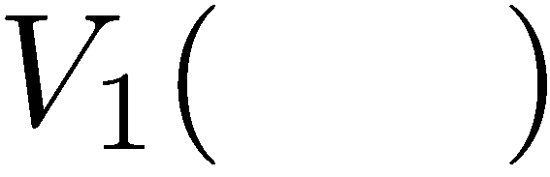
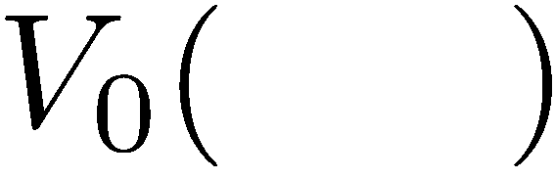
Computing Time-Limited Values

Slide 44
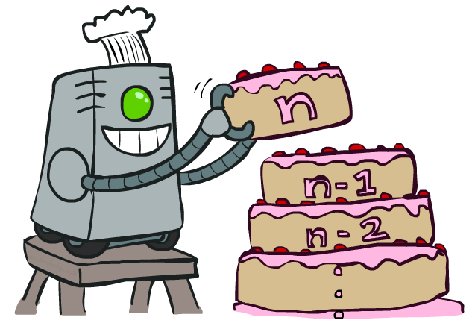
状态赋值迭代 Value Iteration
Notes:
From time step t=0 to t=t+1, and continues until values are converged .

Slide 45
状态赋值迭代
开始于 V₀(s) = 0
给定向量 V_{k}(s) 值, 计算一步期望最大值，根据以下公式:
重复这个过程，直到收敛
每步迭代的计算时间复杂度: O(S²A)
定理: 这个过程将会收敛于唯一的最优值
V_{k+1}(s)
a
s, a
s,a,s’
V_{k}(s’)
Notes:
Discuss computational complexity: S * A * S times number of iterations （from the formula, for each state value it involves computation of A * S, and there are S values in a V(s) vector.）
Note: updates not in place [if in place, it means something else and not even clear what it means]
开始于 V₀(s) = 0: 时间步长剩余为零 means an expected reward sum of zero。
定理: 这个过程将会收敛于唯一的最优值
Basic idea: approximations get refined towards optimal values
Policy may converge long before values do

Slide 46

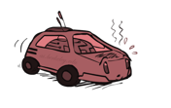
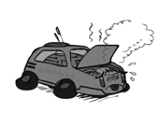
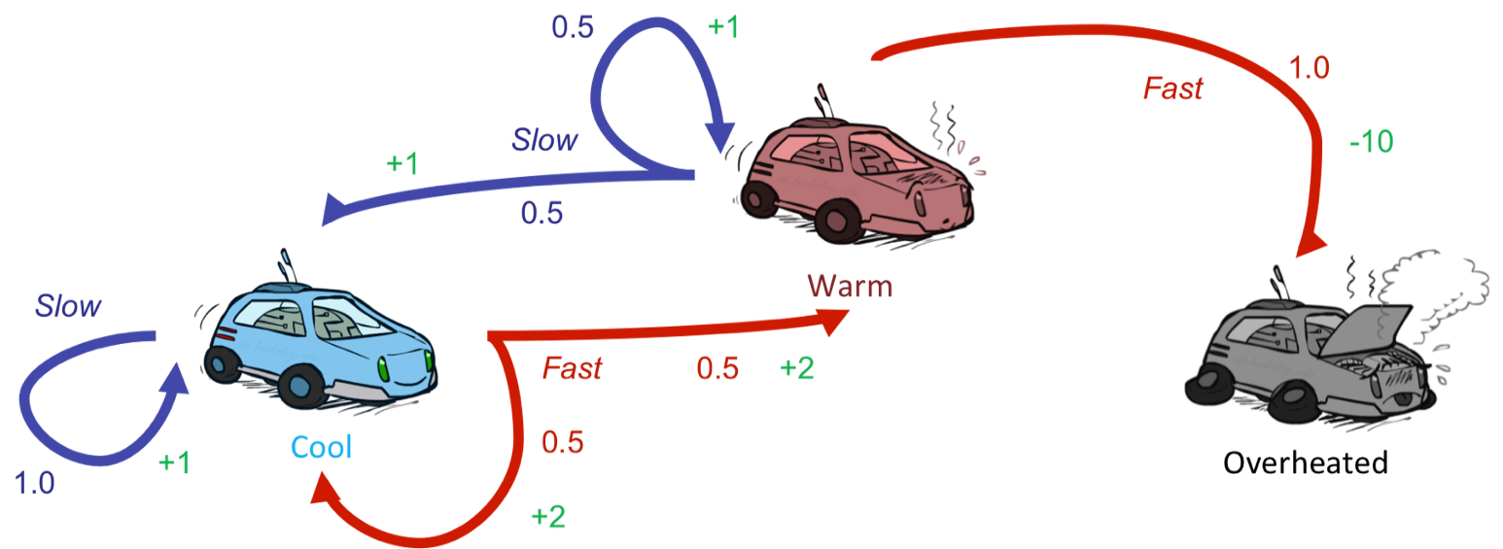
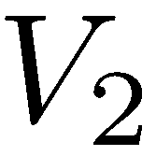
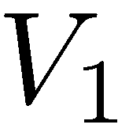
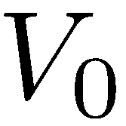
举例:赋值迭代
S: 1
F: .5*2+.5*2=2
假设没有折扣值 !
0 0 0

Slide 47
举例:赋值迭代
2
S: .5*1+.5*1=1
假设没有折扣值 !
F: -10
0 0 0

Slide 48
举例:赋值迭代
2
1
0
假设没有折扣值 !
0 0 0

Slide 49
举例:赋值迭代
S: 1+2=3
F: .5*(2+2)+.5*(2+1)=3.5
2
1
0
0 0 0
假设没有折扣值 !

Slide 50
举例:赋值迭代
3.5
2.5
0
2
1
0
0 0 0
假设没有折扣值 !

Slide 51
MDP 第二部分

Slide 52
Example: Grid World
A maze-like problem
  The agent lives in a grid
  Walls block the agent’s path
Noisy movement: actions do not always go as planned
  80% of the time,
  the action North takes the agent North
  10% of the time, North takes the agent West; 10% East
  If there is a wall in the direction the agent would have been taken, the agent stays put
The agent receives rewards each time step
  Small “living” reward each step (can be negative)
  Big rewards come at the end (good or bad)
Goal: maximize sum of (discounted) rewards
Notes:
[cut demo of moving around in grid world program]
A MDP example.

Slide 53
Recap: MDPs
Markov decision processes:
  States S
  Actions A
  Transitions P(s’|s,a) (or T(s,a,s’))
  Rewards R(s,a,s’) (and discount γ)
  Start state s₀
Quantities:
  Policy = map of states to actions
  Utility = sum of discounted rewards
  Values = expected future utility from a state (max node)
  Q-Values = expected future utility from a q-state (chance node)
s
a
s, a
s,a,s’
s’
Notes:
Pick the best action, a.

Slide 54
Optimal Quantities
The value (utility) of a state s:
  V*(s) = expected utility starting in s and acting optimally
The value (utility) of a q-state (s,a):
  Q*(s,a) = expected utility starting out having taken action a from state s and (thereafter) acting optimally
The optimal policy:
  π*(s) = optimal action from state s
s
s is a state
a
(s, a) is a q-state
s, a
s,a,s’
(s,a,s’) is a
transition
s’
[Demo: gridworld values (L9D1)]
Notes:
Demo just shows V and Q values, snapshots on next slides.

Slide 55
Snapshot of Gridworld - V Values
Noise = 0.2
Discount = 0.9
Living reward = 0
Notes:
Optimal value of state.
Arrows converges much earlier.

Slide 56
Snapshot of Gridworld - Q Values
Noise = 0.2
Discount = 0.9
Living reward = 0
Notes:
Q-state values.
Q values each state position with four actions (going four directions).
From here we can actually infer the current optimal policy (optimal action for each state at current step).
Optimal policy shown by the arrows.

Slide 57

The Bellman Equations
How to be optimal:
Step 1: Take correct first action
Step 2: Keep being optimal

Slide 58

The Bellman Equations
Definition of “optimal utility” via expectimax recurrence gives a simple one-step lookahead relationship amongst optimal utility values
These are the Bellman equations, and they characterize optimal values in a way we’ll use over and over
s
a
s, a
s,a,s’
s’
Notes:
Let’s start by equations that characterize these quantities through mutual recursions. [step through this by writing on slide, one step at a time]
Recursive characterization of V* in terms of V*; not necessarily helpful; but it is a characterization.
Note: this is a set of equations that needs to be satisfied; but it could have multiple solutions (it does not, but at this stage of our knowledge it could).

Slide 59
Value Iteration (值迭代)
Bellman equations characterize the optimal values:
Value iteration computes them:
Value iteration is just a fixed point solution method
  … though the V_{k} vectors are also interpretable as time-limited values
V(s)
a
s, a
s,a,s’
V(s’)
Notes:
Discuss computational complexity: S * A * S times number of iterations
Note: updates not in place [if in place, it means something else and not even clear what it means]

Slide 60
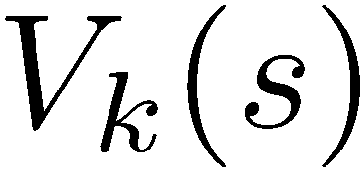

Convergence* （收敛）
How do we know the V_{k} vectors are going to converge?
Case 1: If the tree has maximum depth M, then V_{M} holds the actual untruncated values
Case 2: If the discount is less than 1
  Sketch: For any state V_{k} and V_{k+1} can be viewed as depth k+1 expectimax results in nearly identical search trees
  The difference is that on the bottom layer, V_{k+1} has actual rewards while V_{k} has zeros
  That last layer is at best all R_{MAX}
  It is at worst R_{MIN}
  But everything is discounted by γ^{k} that far out
  So V_{k} and V_{k+1} are at most γ^{k} max|R| different
  So as k increases, the values converge

Slide 61

基于策略的求解MDP方法
Policy Methods
Notes:
Value iteration can be very slow.
If gamma = 1, V values can’t converge.

Slide 62

策略评价
Notes:
Given a policy, evaluate how good the policy is.

Slide 63
固定的策略
采取最优行动
按照策略 π 选择行动
s
s
a
π(s)
s, a
s, π(s)
s,a,s’
s, π(s),s’
s’
s’
期望最大值搜索树在所有行动分支里选择最大功效值
如果使用一个给定的策略 π(s), 那么这个搜索树变得比以前要简单 – 每个状态节点只有一个分支
  … 所以搜索树的状态节点值的计算将取决于我们所固定（使用）的那个策略

Slide 64
用来评价一个固定的策略的功效值
当给定一个策略（通常不是最优的）时，如何计算一个状态 s 的功效值
给定策略 π 下，定义一个状态 s 的功效值为:
  V^{π}(s) = 从状态 s 开始，按照策略 π 执行，所获得的期望折扣奖赏值的总计
迭代关系 (基于 Bellman 公式的一步计算):
s
π(s)
s, π(s)
s, π(s),s’
s’
Notes:
The bigger V values, the better policy is.
Linear equations to solve the V(s).

Slide 65


举例: 策略评价
Always Go Right
Always Go Forward

Slide 66


举例: 策略评价
Always Go Right
Always Go Forward
Notes:
Don’t worry about the numbers (how to calculate them) right now.
You can think of the policies as something you can search of.

Slide 67

策略评价
给定一个策略π，如何计算 V-值?
思路 1: 基于 Bellman 方程的赋值迭代更新
  效率: O(S²) 每步迭代
思路 2: 由于没有了“最大符号”, Bellman 方程变为了 一个线性系统
s
π(s)
s, π(s)
s, π(s),s’
s’
Notes:
Just like a value iteration without the max symbol.
思路 2: 由于没有了“最大符号”, Bellman 方程变为了 一个线性系统
Solve with Matlab (or your favorite linear system solver)

Slide 68

策略提取 Policy Extraction

Slide 69



从状态值计算行动
假设我们已有了每个状态的最优值 V*(s)
那么我们如何选择行动?
  不是很明显!
需要计算一步长的 mini-expectimax：
这叫做 策略提取, 通过计算期望最大值，间接地获得最优行动选择

Slide 70


从Q-值计算行动
假设我们已有了最优的 q-values:
现在我们如何挑选行动?
  此时变得很简单!
因此: 为每个状态位置选择最优行动从Q-值中比在状态值中更容易!

Slide 71

策略迭代法 Policy Iteration

Slide 72
状态赋值迭代方法的缺点
赋值迭代实现的是基于 Bellman 方程的更新公式：
问题 1: 很慢 –每次迭代的复杂度是 O(S²A)
问题 2: 在每个位置（状态）的 “最大”选项很少改变
问题 3: 策略 policy 通常比状态值收敛的更快
s
a
s, a
s,a,s’
s’
Notes:
Demo steps through value iteration; snapshots of values shown on next slides.
Policy looks the max (value) for choosing the best action, that “max” changes less than the V-value changes.

Slide 73
k=0
Noise = 0.2
Discount = 0.9
Living reward = 0
Notes:
Assuming zero living reward

Slide 74
k=1
Noise = 0.2
Discount = 0.9
Living reward = 0
Notes:
Assuming zero living reward

Slide 75
k=2
Noise = 0.2
Discount = 0.9
Living reward = 0
Notes:
Assuming zero living reward

Slide 76
k=3
Noise = 0.2
Discount = 0.9
Living reward = 0
Notes:
Assuming zero living reward

Slide 77
k=4
Noise = 0.2
Discount = 0.9
Living reward = 0
Notes:
Assuming zero living reward

Slide 78
k=5
Noise = 0.2
Discount = 0.9
Living reward = 0
Notes:
Assuming zero living reward

Slide 79
k=6
Noise = 0.2
Discount = 0.9
Living reward = 0
Notes:
Assuming zero living reward

Slide 80
k=7
Noise = 0.2
Discount = 0.9
Living reward = 0
Notes:
Assuming zero living reward

Slide 81
k=8
Noise = 0.2
Discount = 0.9
Living reward = 0
Notes:
Assuming zero living reward

Slide 82
k=9
Noise = 0.2
Discount = 0.9
Living reward = 0
Notes:
Assuming zero living reward

Slide 83
k=10
Noise = 0.2
Discount = 0.9
Living reward = 0
Notes:
Assuming zero living reward

Slide 84
k=11
Noise = 0.2
Discount = 0.9
Living reward = 0
Notes:
Assuming zero living reward

Slide 85
k=12
Noise = 0.2
Discount = 0.9
Living reward = 0
Notes:
Assuming zero living reward

Slide 86
k=100
Noise = 0.2
Discount = 0.9
Living reward = 0
Notes:
Assuming zero living reward

Slide 87
策略迭代法 Policy Iteration
另一种方法求解最优值:
  步骤 1: 策略评价: 给定某个固定的行动策略，计算各个状态值 (尽管他们不是代表最优的状态值!) ，迭代计算，直到这个状态值收敛
  步骤 2: 策略改进: 更新行动策略，使用向前一步的计算，使用之前迭代计算收敛的 (but not optimal!) 状态值（作为未来的状态值）
  重复这两步直到行动策略收敛
Notes:
This is policy iteration
It’s still optimal!
Can converge (much) faster under some conditions

Slide 88
策略迭代法 （Policy iteration）
策略评价: 对于当前的策略 π, 使用策略评价过程计算状态位置的值:
  迭代直至V-值收敛
策略改进: 给定计算出来的V-值, 通过策略提取过程，计算获得更好一步的策略
  向前 一步的 计算:

Slide 89
比较
状态值迭代和策略迭代方法计算的是同一件事情 (所有状态节点的最优功效值)
在状态赋值迭代里:
  每次迭代，更新状态V-值,和策略(隐式地)
  没有直接追踪策略, 但是从不同行动分支中获取一个最大值时，实际上隐式地计算了策略
在策略迭代里:
  我们在当前固定的策略下，通过几次迭代，更新计算状态的功效值(V-值) (每次迭代很快，因为我们此时只考虑一个行动, 而不是所有的行动分支)
  在当前策略评价过程完成以后, 一个新的策略被挑选出来 (这一步较慢，就像状态赋值迭代方法里的一次迭代)
  新的策略将会更优化 (否则的话，迭代过程结束)
Both are dynamic programs for solving MDPs

Slide 90
总结: MDP 算法
我们用到的算法：
  计算状态节点的最优功效值: 使用状态赋值迭代，或策略迭代方法
  给定一个策略，计算状态值: 使用策略评价方法
  通过状态值获取一个策略: 使用策略提取方法（向前一步优化）
这些方法看上去都很像!
  它们本质上都是基于 Bellman 赋值更新表达式
  全都使用了基于期望最大值的向前一步优化计算模块
  它们区别只是在于是否固定一个策略，或是在所有行动分支中进行最优挑选（最大化期望功效值的行动）

Slide 91



Double Bandits
Notes:
The Blue: it will give you a 1$ every time you pull the lever; The red: it will either give you $0 or $2 ever time you pull the lever.

Slide 92
Double-Bandit MDP
No discount
100 time steps
Both states have the same value
Actions: Blue, Red
States: Win, Lose
0.25 $0
0.75
$2
W
L
0.25
$0
$1
1.0
$1
1.0
0.75 $2
Notes:
What’s the expected values when you play 100 times of blue slot machine, or play 100 times of red slot machine?

Slide 93
Offline Planning
No discount
100 time steps
Both states have the same value
Solving MDPs is offline planning
  You determine all quantities through computation
  You need to know the details of the MDP
  You do not actually play the game!
0.25 $0
Value
0.75
$2
Play Red
W
0.25
$0
150
L
$1
1.0
$1
1.0
Play Blue
0.75 $2
100
Notes:
If MDP structure (model) is known (all parameters are known), then we can do offline computation, and choose the best action.
So choosing action of play red.

Slide 94
Let’s Play!
$2
$2
$0
$2
$2
$2
$2
$0
$0
$0
Notes:
Real time playing the faked game 10 times (choosing play the red machine as we made the decision offline). Outcome is total 12$, not so bad compared with expected $15.

Slide 95
Online Planning
Rules changed! Red’s win chance is different.
?? $0
??
$2
W
L
??
$0
$1
1.0
$1
1.0
?? $2

Slide 96
Let’s Play!
$0
$0
$0
$2
$0
$2
$0
$0
$0
$0
Notes:
How can we figure out the probability parameters? We have to play it.
After the play, asking audience which machine to play then.

Slide 97

What Just Happened?
That wasn’t planning, it was learning!
  Specifically, reinforcement learning (增强学习)
  There was an MDP, but you couldn’t solve it with just computation
  You needed to actually act to figure it out
Important ideas in reinforcement learning that came up
  Exploration （探索）: you have to try unknown actions to get information
  Exploitation （利用）: eventually, you have to use what you know
  Regret: even if you learn intelligently, you make mistakes
  Sampling: because of chance, you have to try things repeatedly
  Difficulty: learning can be much harder than solving a known MDP
Notes:
You need to play and take observations (samples), and use its to figure out the parameters of MDP behind the scene.
Regret: Experience can cost.

Slide 98
Next Time: Reinforcement Learning!

Slide 99

Asynchronous Value Iteration*
In value iteration, we update every state in each iteration
  Actually, any sequences of Bellman updates will converge if every state is visited infinitely often
In fact, we can update the policy as seldom or often as we like, and we will still converge
Idea: Update states whose value we expect to change:
If is large then update predecessors of s

